Slide 1
AWS
CH.SATVIKA
20A31A4207

Slide 2
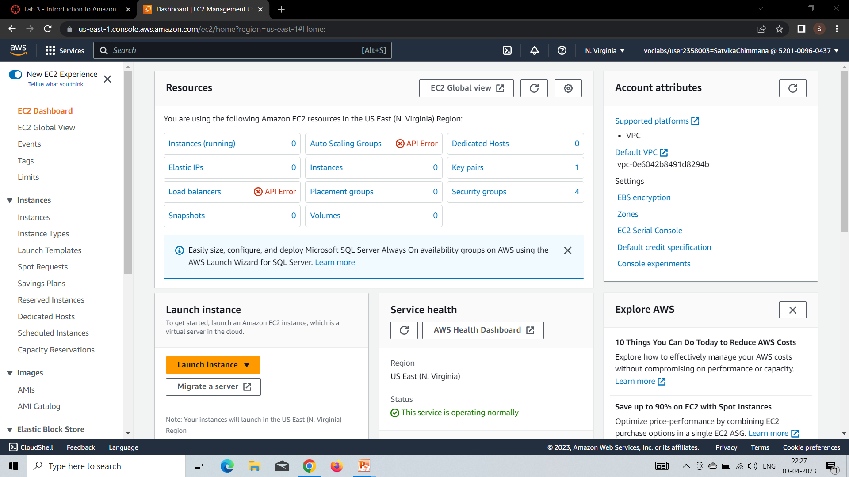
AWS EC2(Elastic Compute cloud)
In the AWS Management Console choose services , choose ec2
On left side we see instances .choose instances

Slide 3
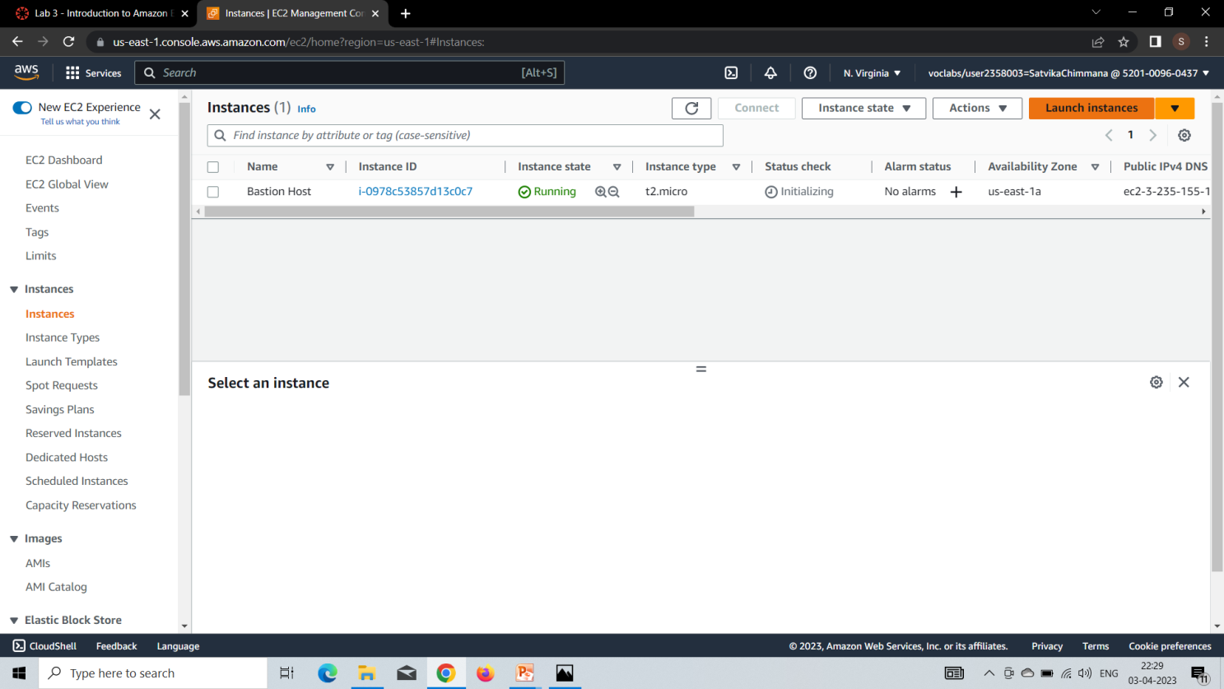
Choose the Launch instance menu and select Launch instance.

Slide 4
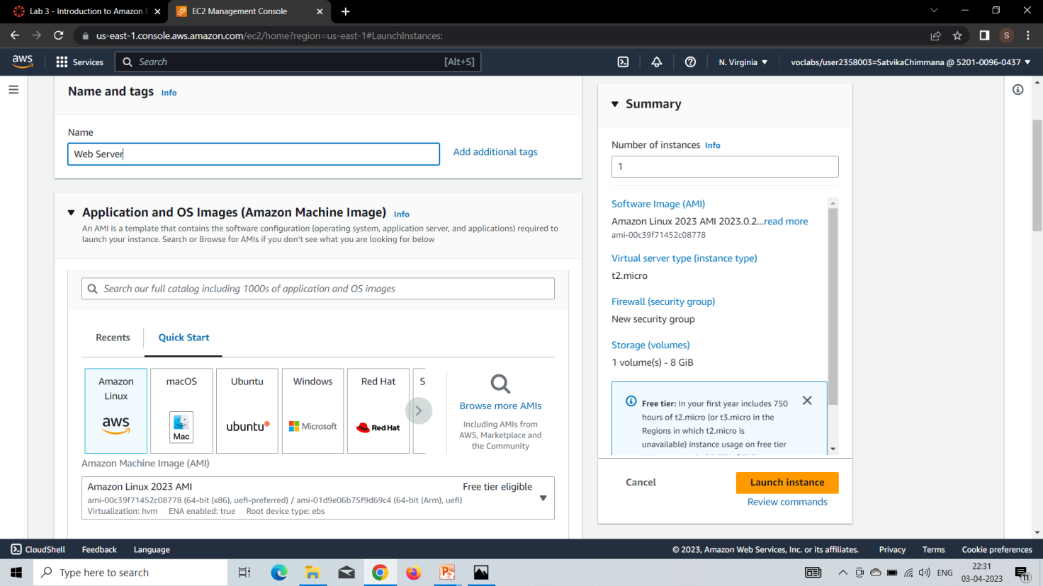
Give the instance the name Web Server
In the list of available Quick Start AMIs, keep the default Amazon Linux AMI selected.

Slide 5
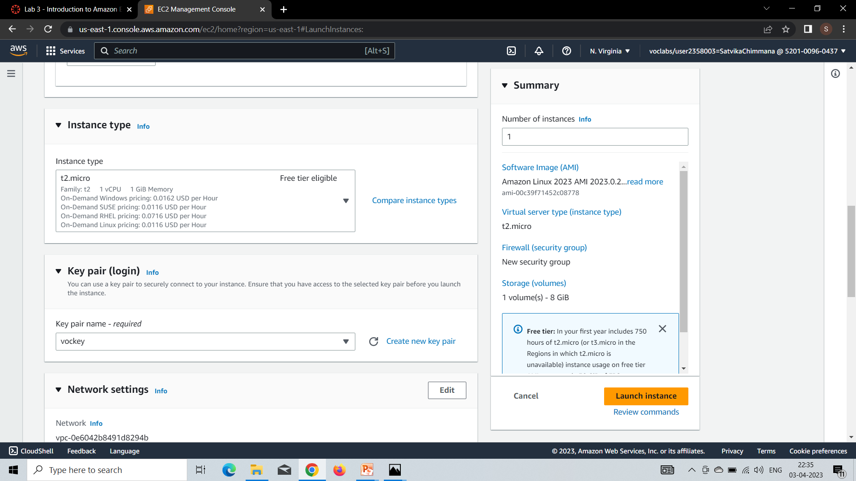
In the Instance type panel, keep the default t2.micro
For Key pair name - required, choose vockey selected.

Slide 6
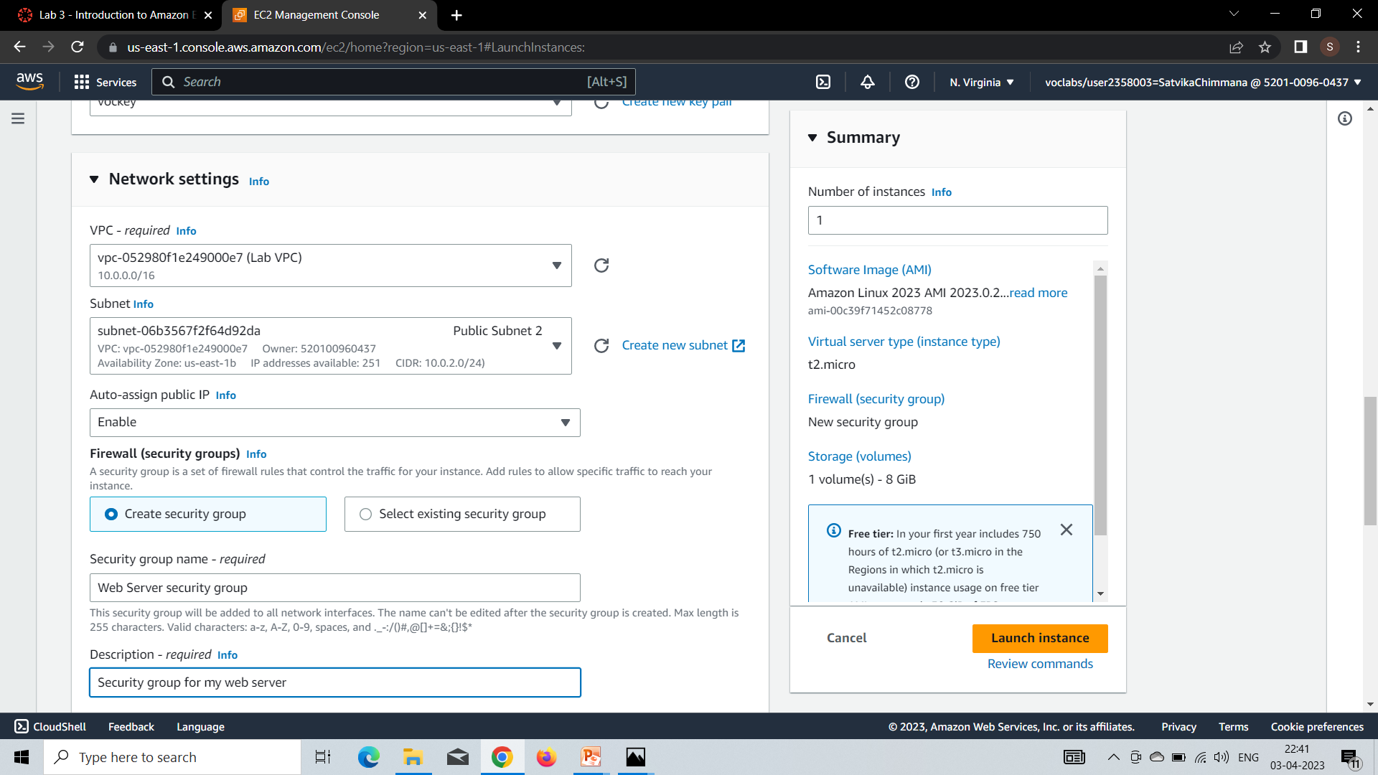
Next we will go to network settings and click edit.
For VPC, select Lab VPC.
Under Firewall (security groups), we choose Create security group and configure: Security group name: Web Server security group,Description: Security group for my web server

Slide 7
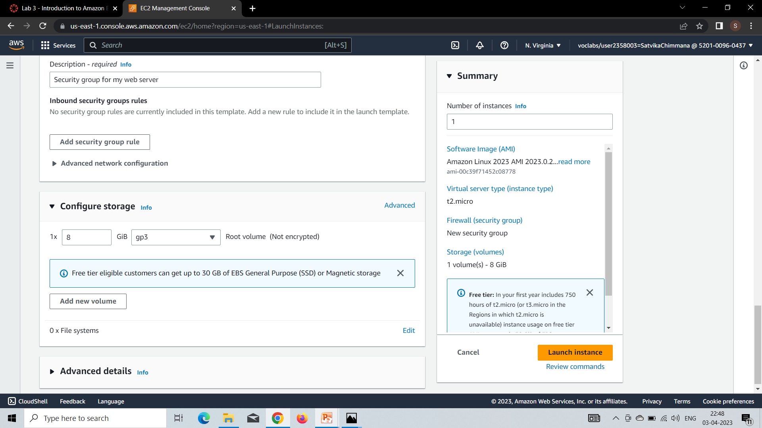
Under Inbound security group rules, notice that one rule exists. Remove this rule.
In the Configure storage section, keep the default settings.

Slide 8
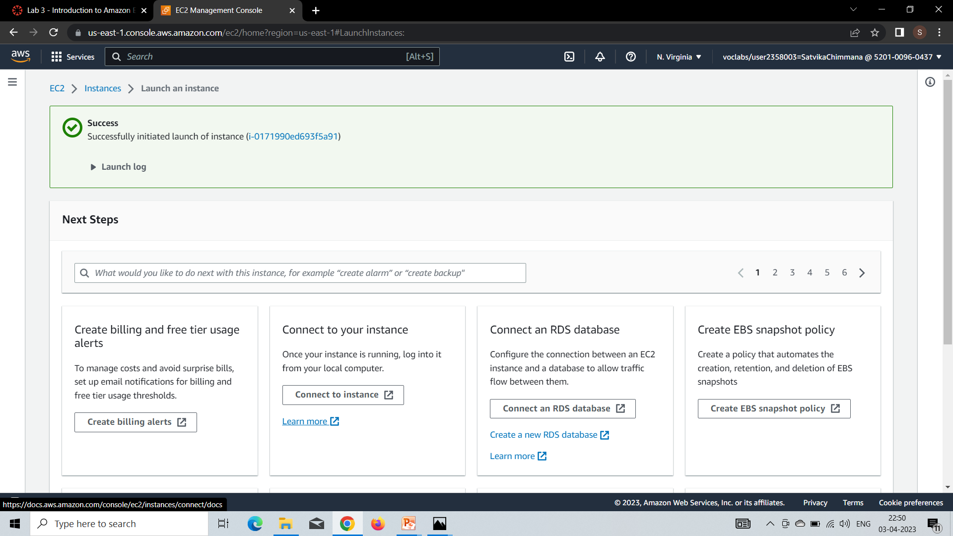
Then click on the launch instances in right side.
It takes few minutes to create instances.
Finally we created an ec2 instances.

Slide 9
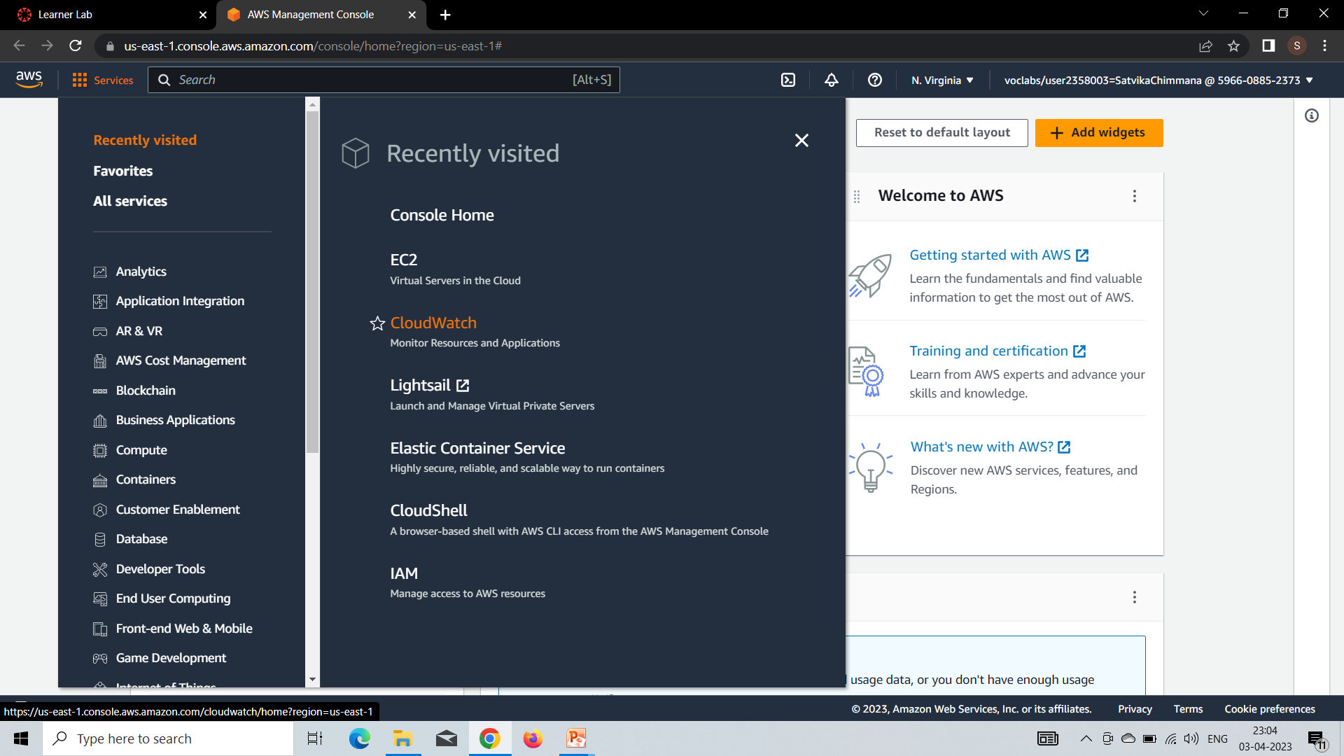
Amazon CloudWatch
In the AWS Management Console choose services , choose cloud watch.

Slide 10
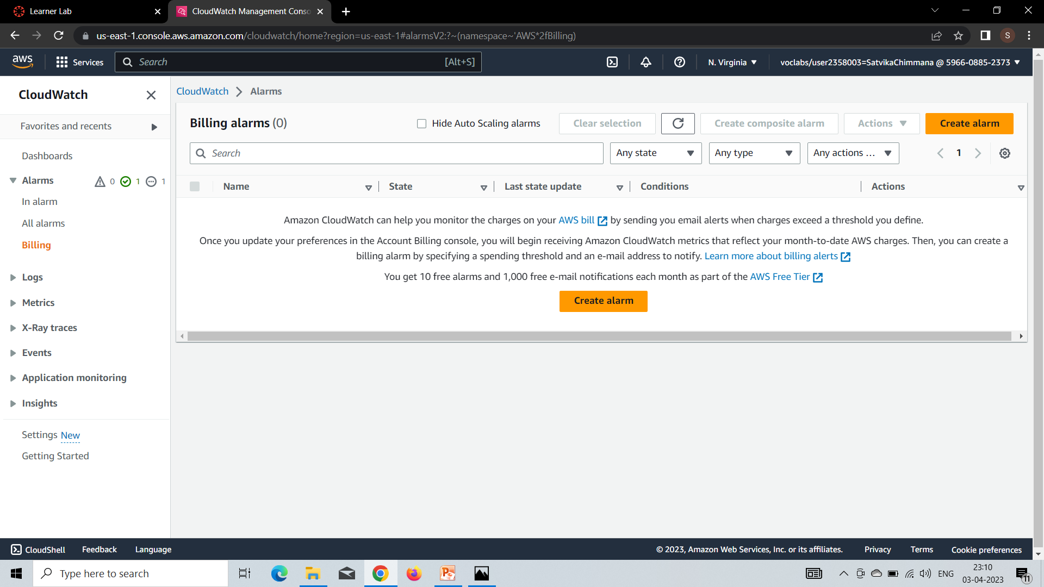
In the left side under alarm,select Billing.
Then click create alarm.

Slide 11
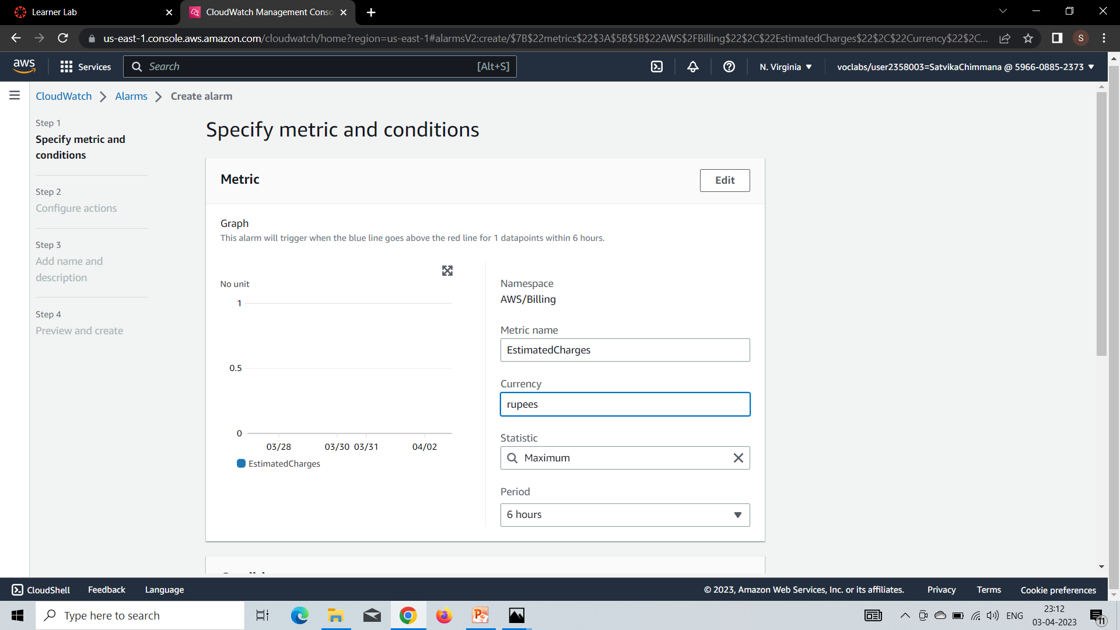
Under currency, type rupees.

Slide 12
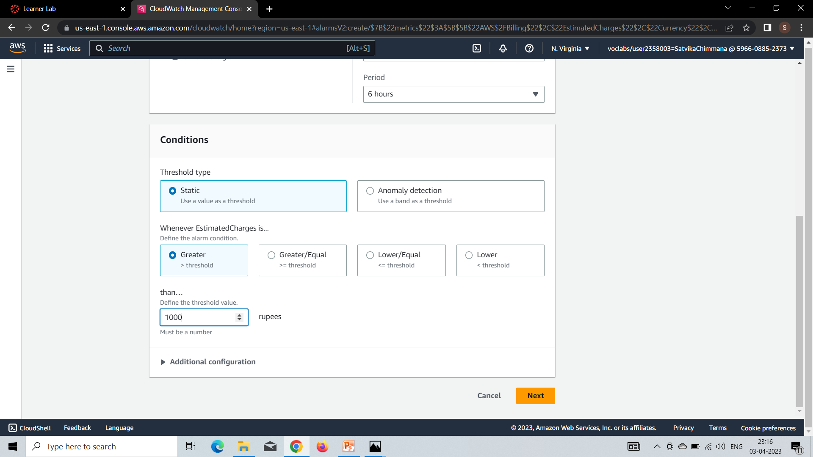
In conditions , leave the default values of Threshold type , whenever estimated charges is...
Define the threshold value to 1000 rupees.
Click Next.

Slide 13
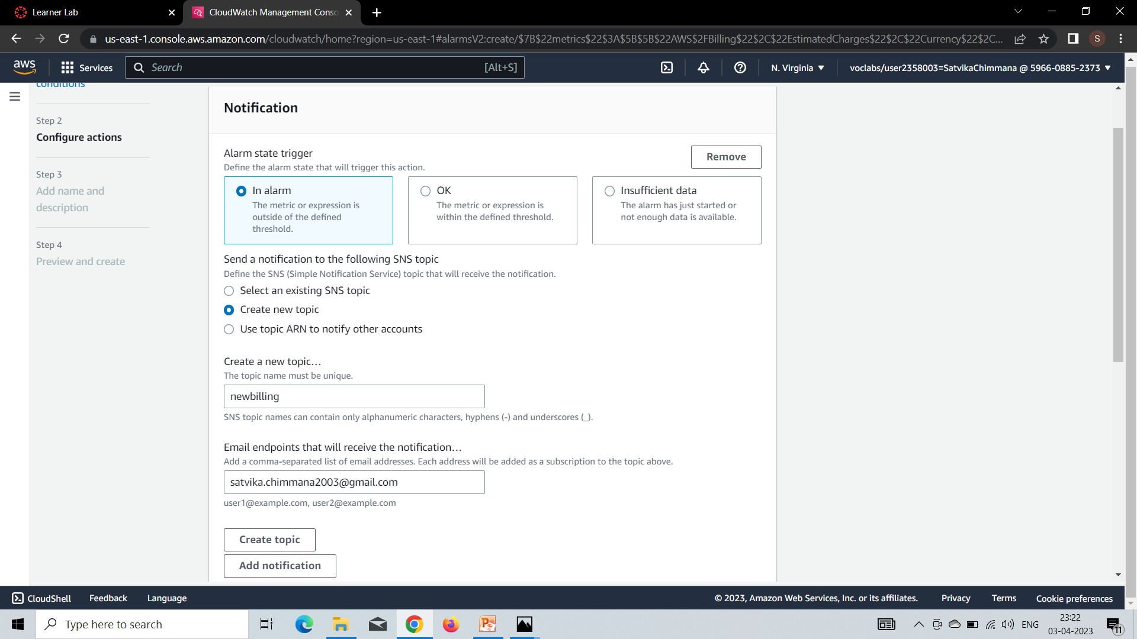
Select create new topic.
Give alarm a name as newbilling.
Enter your email to receive the notifications.
Click on create topic.
And then click on next.

Slide 14
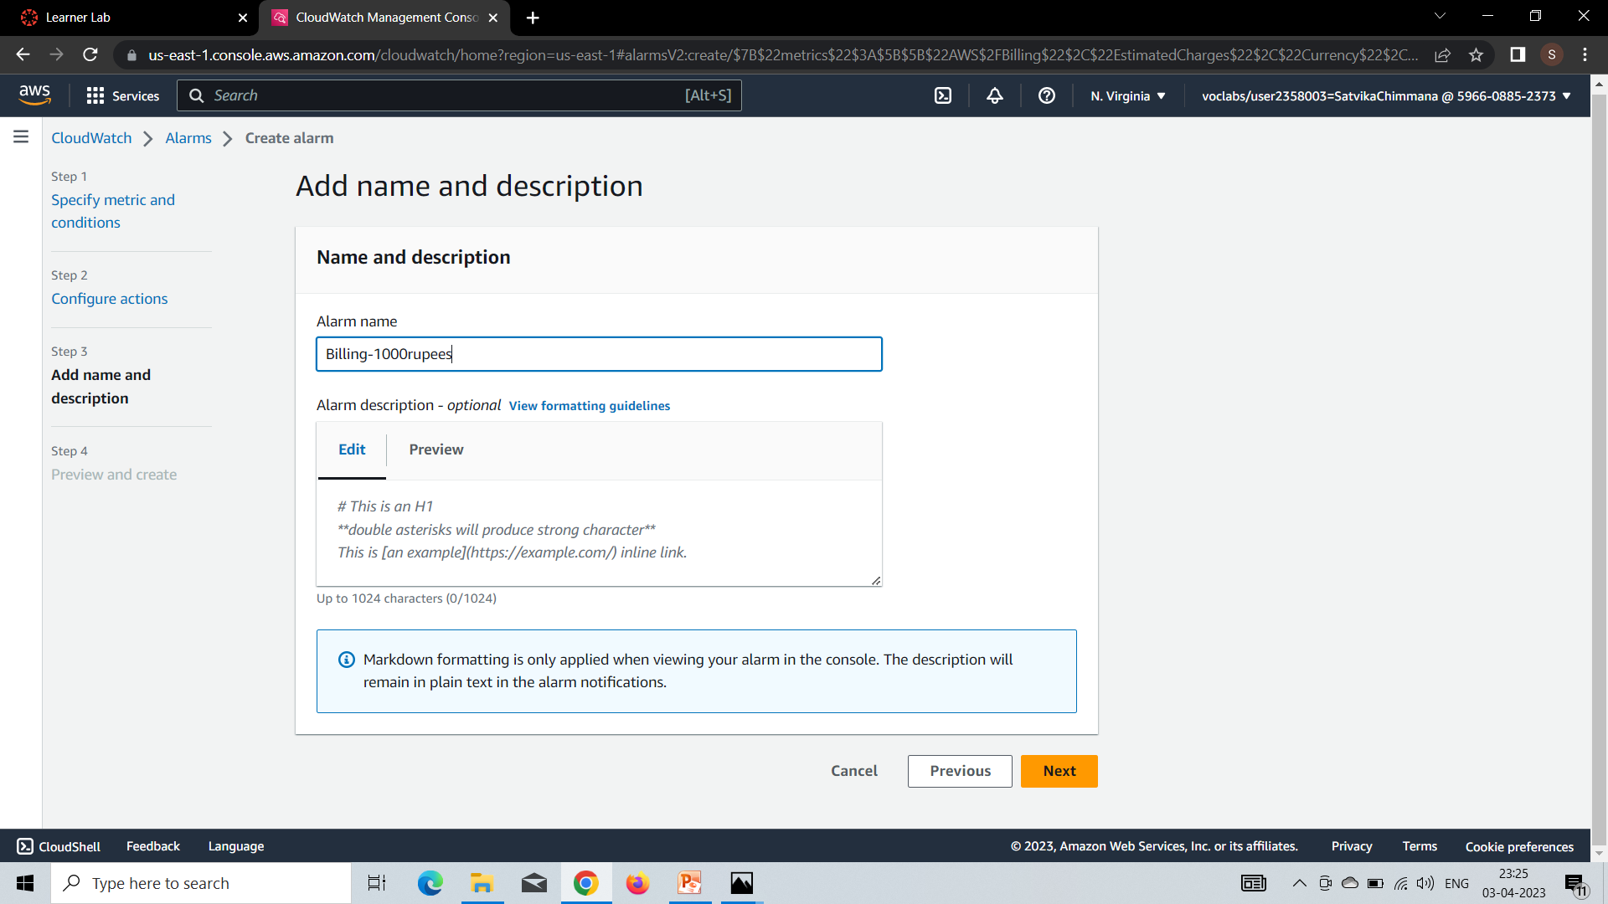
Under alarm name give name as Billing-1000 rupees and click on next.

Slide 15
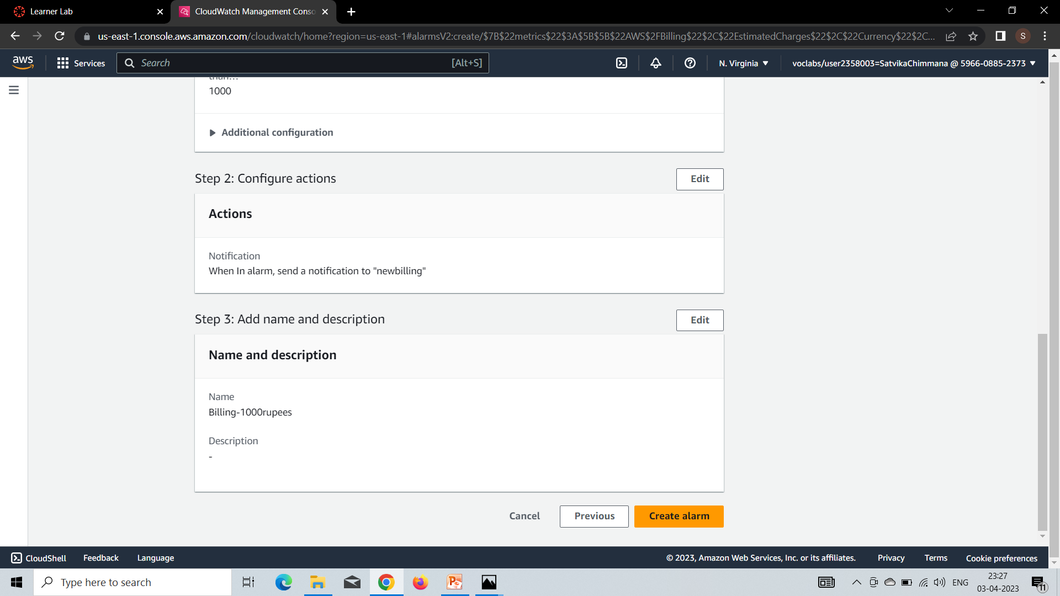
Click on create alarm.

Slide 16
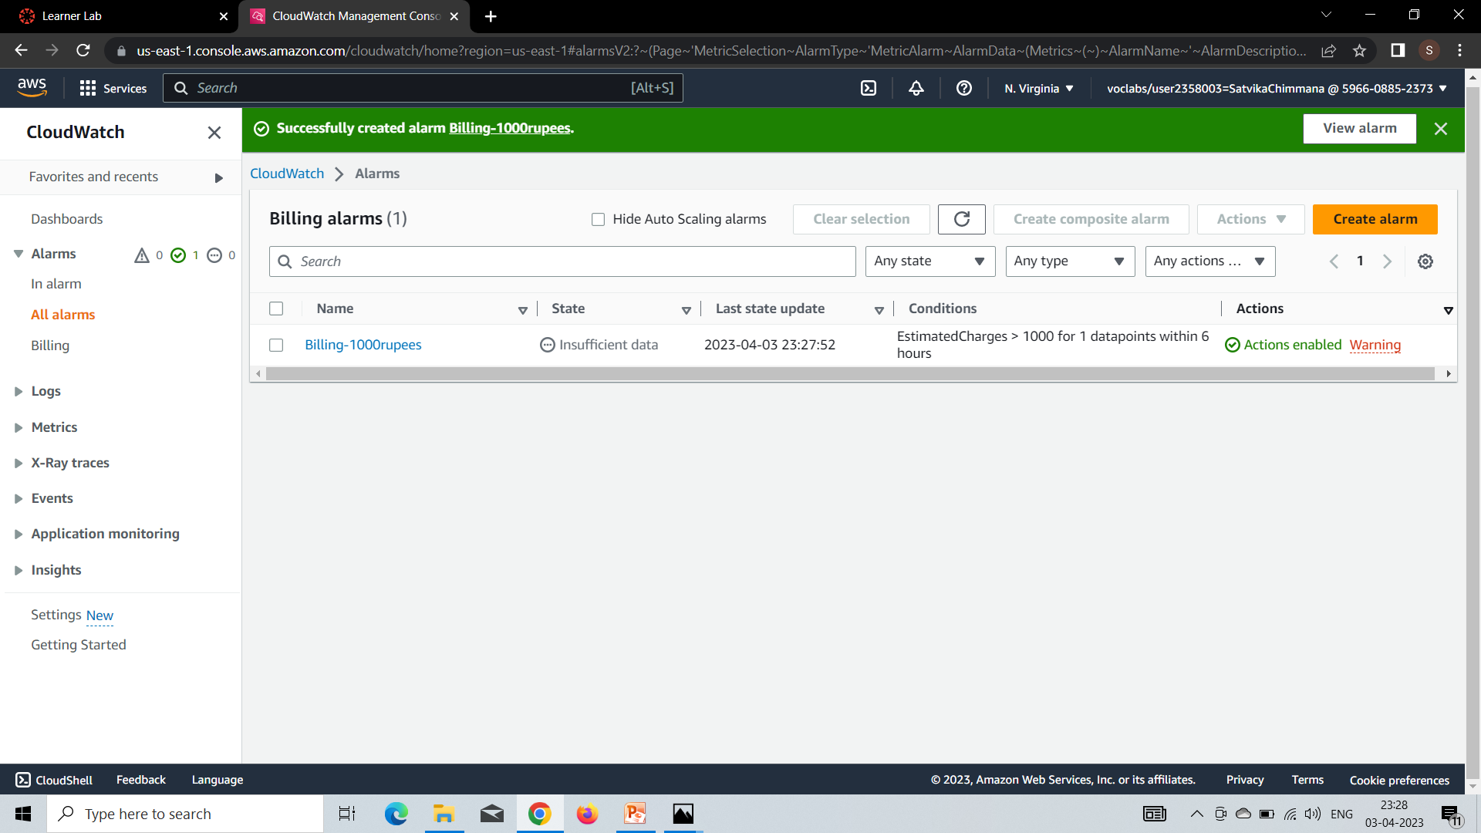
Your alarm is successfully created.

Slide 17
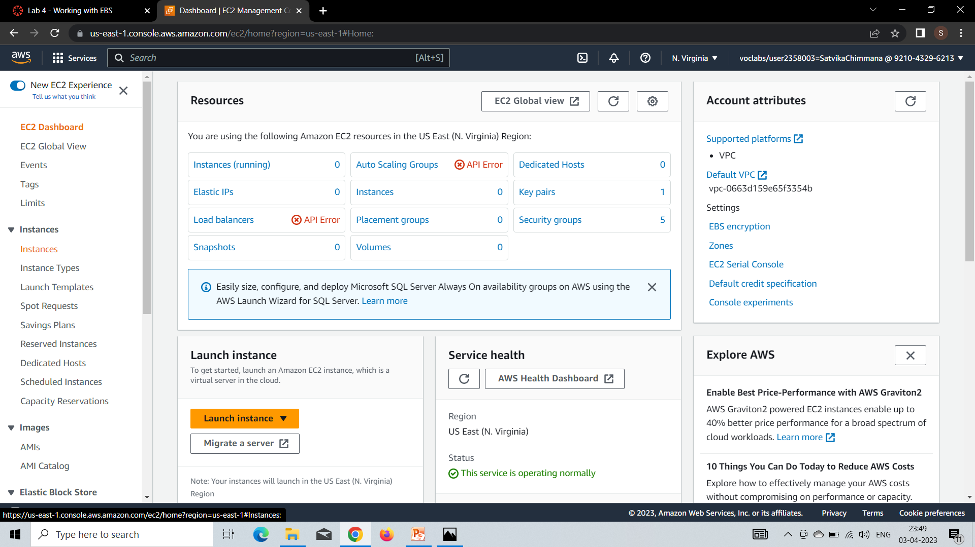
Amazon Elastic Block Store
In the AWS Management Console, on the Services menu, click EC2
In the left
In the left navigation pane, choose Volumes.navigation pane, choose Instances.

Slide 18
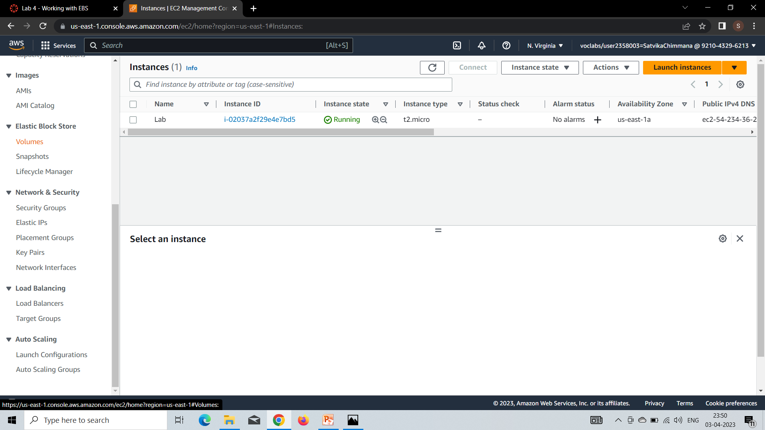
In the left navigation pane, choose Volumes.

Slide 19
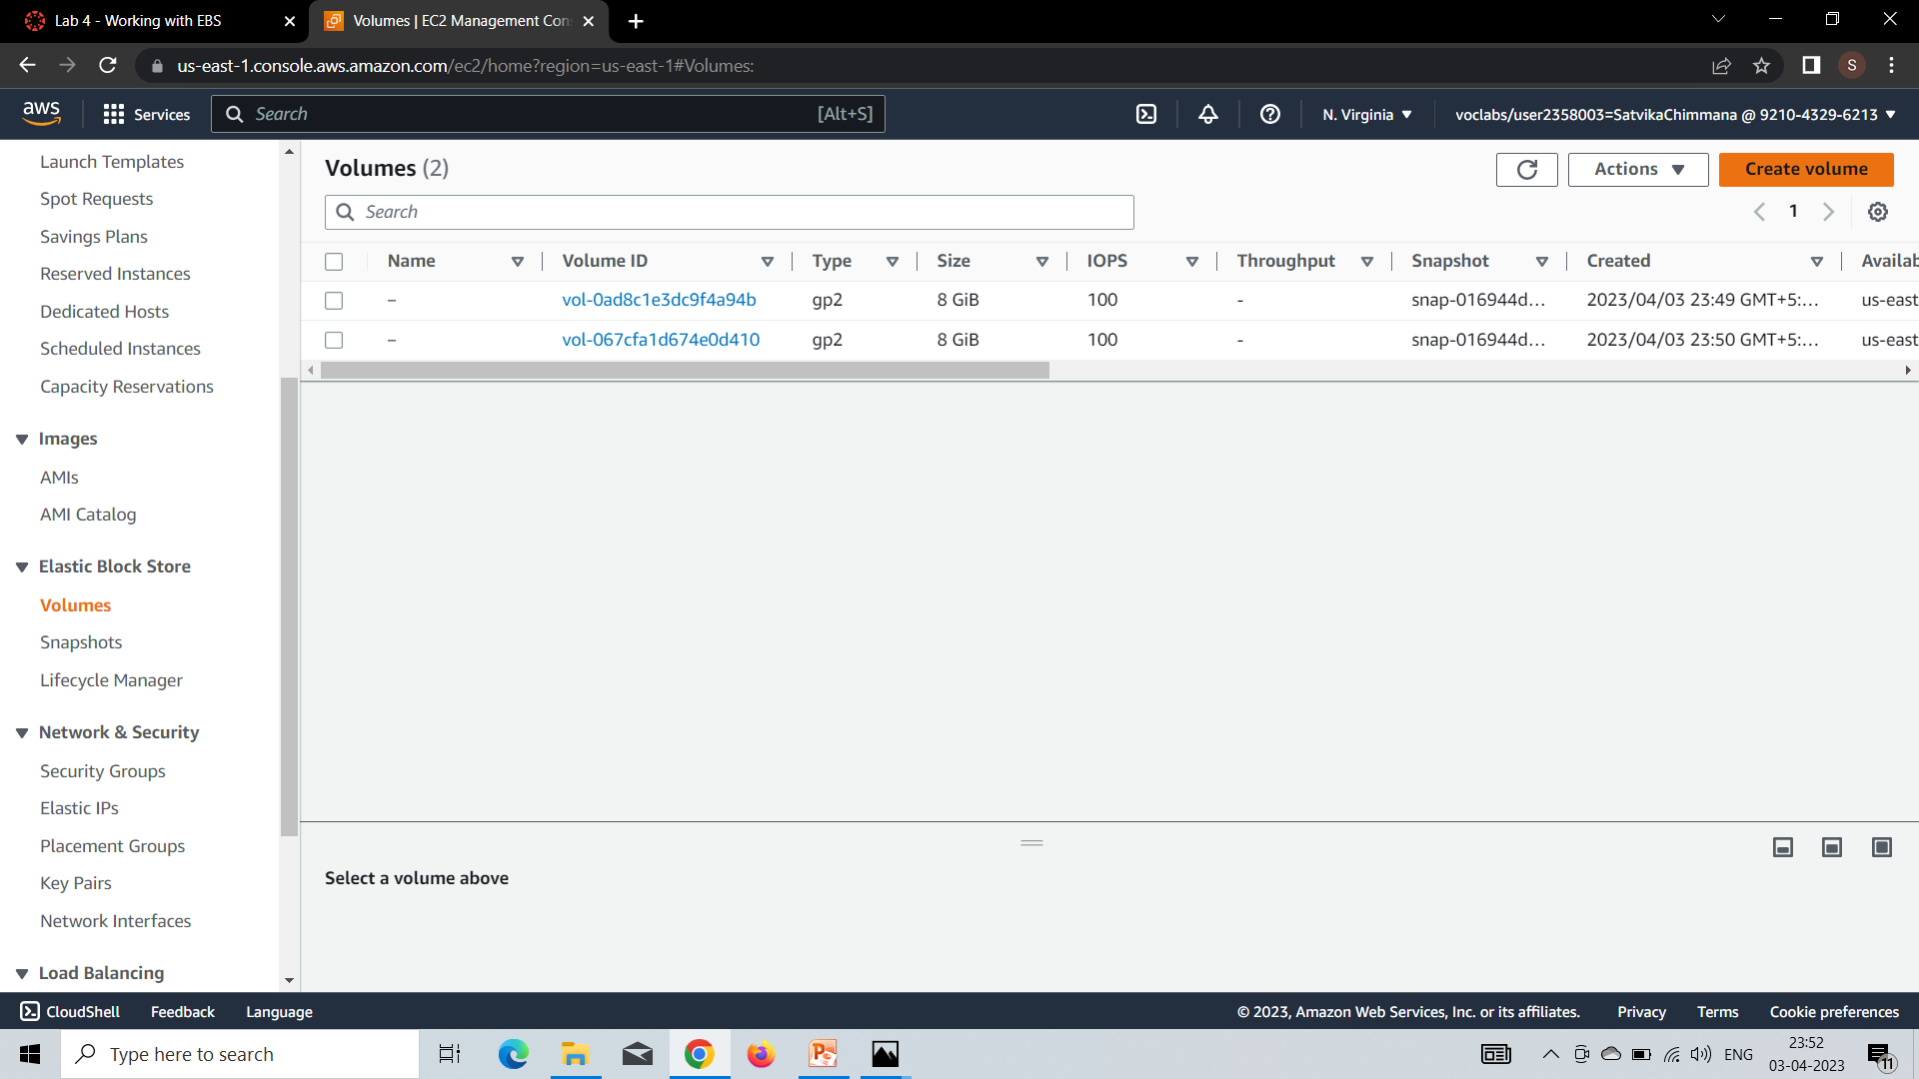
Choose Create volume then configure:

Slide 20
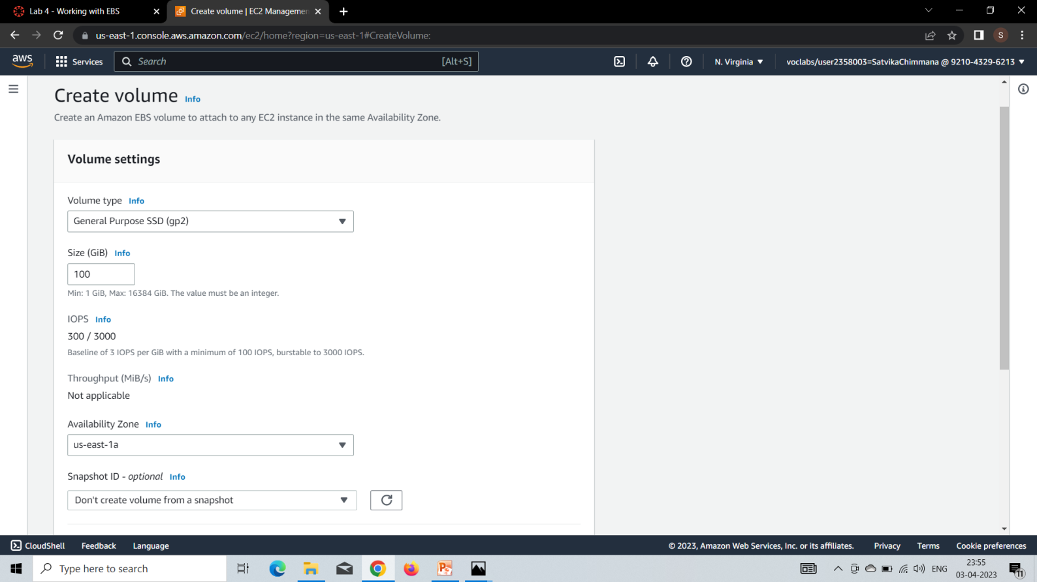
Volume Type: General Purpose SSD (gp2)
Size (GiB): 1. NOTE: You may be restricted from creating large volumes.
Availability Zone: Select the same availability zone as your EC2 instance.

Slide 21
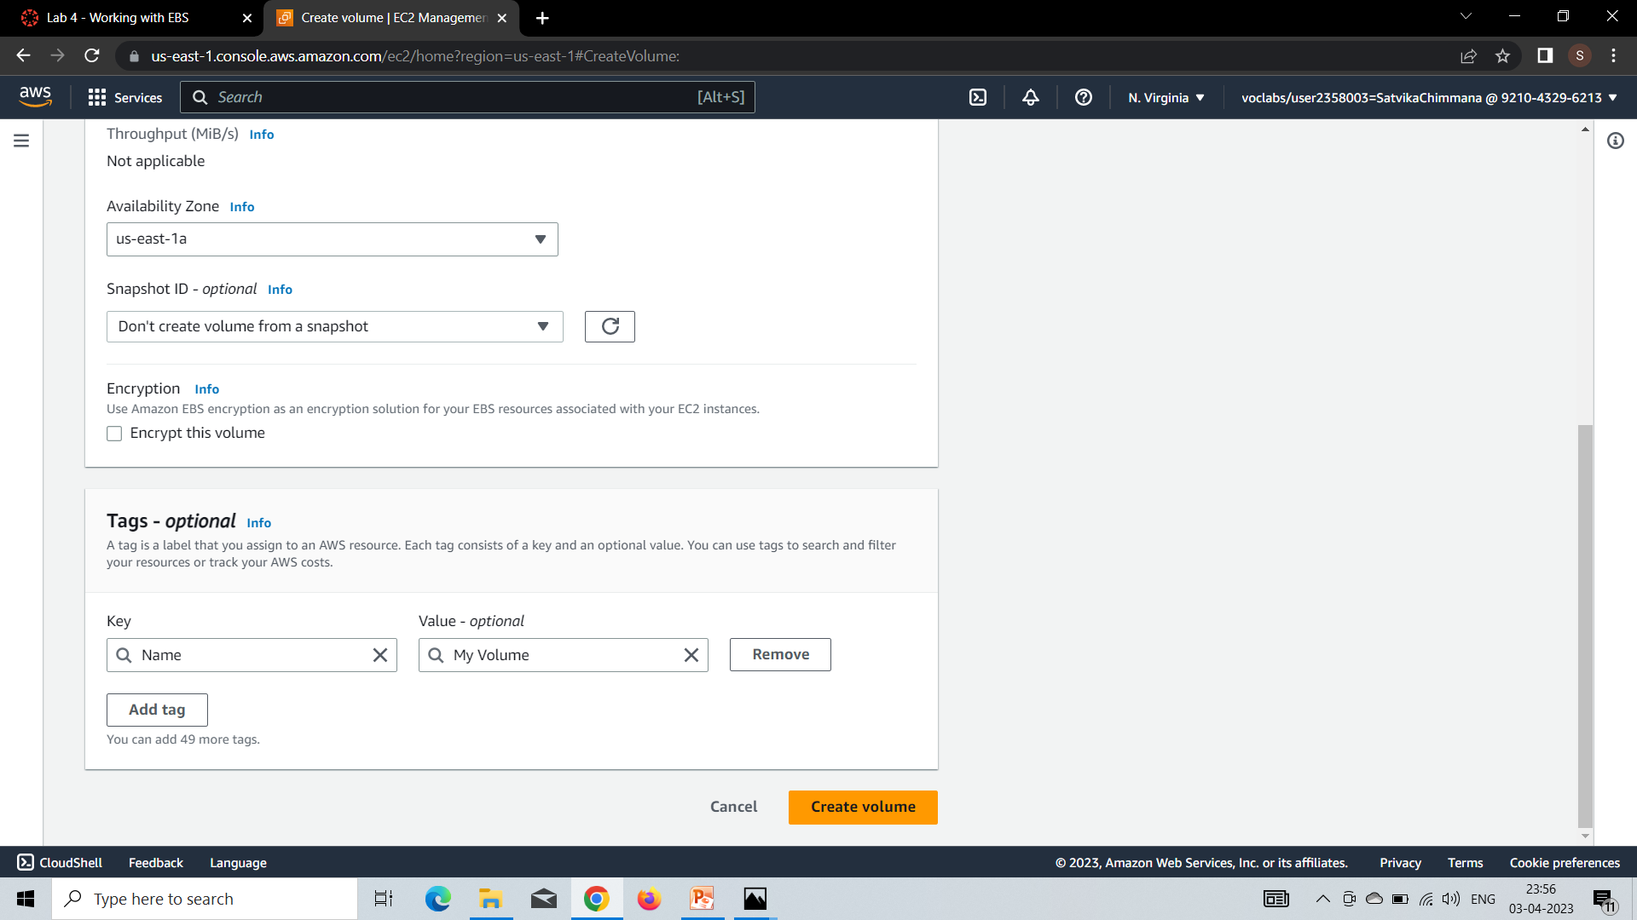
Choose Add Tag
In the Tag Editor, enter:
Key: Name
Value: My Volume
Click on create volume

Slide 22
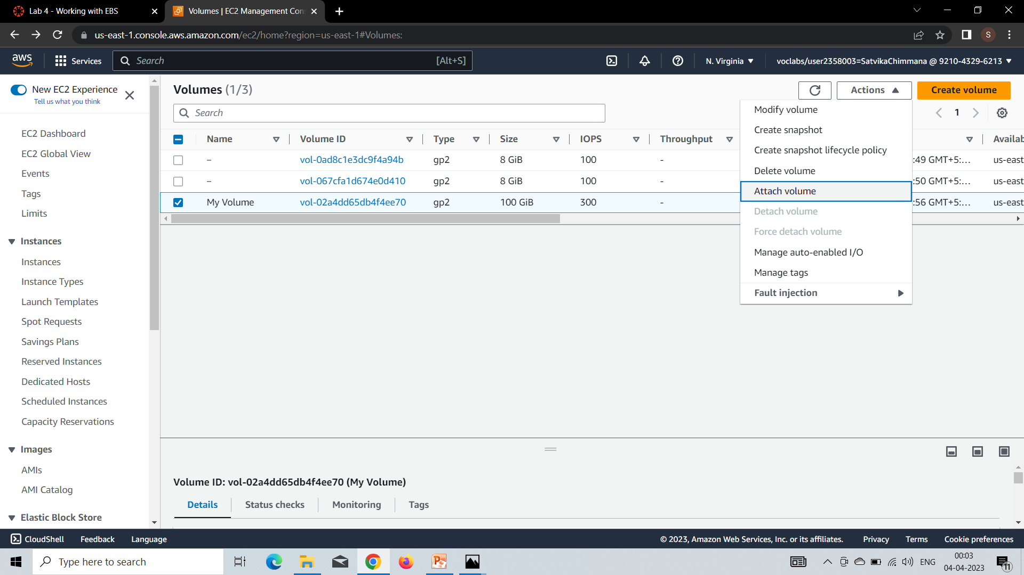
Select My Volume.
In the Actions menu, choose Attach volume.

Slide 23
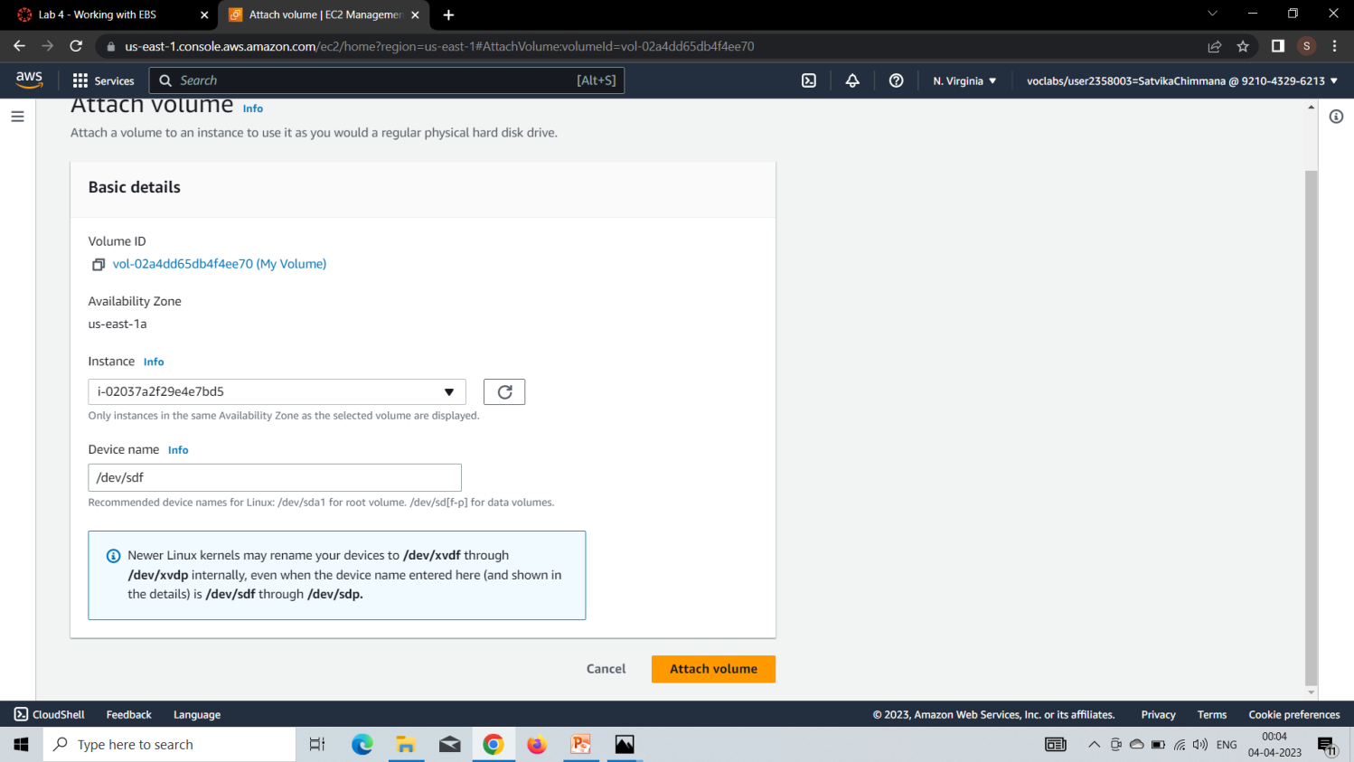
Choose the Instance field, then select the instance that appears(Lab).
Choose Attach volume

Slide 24
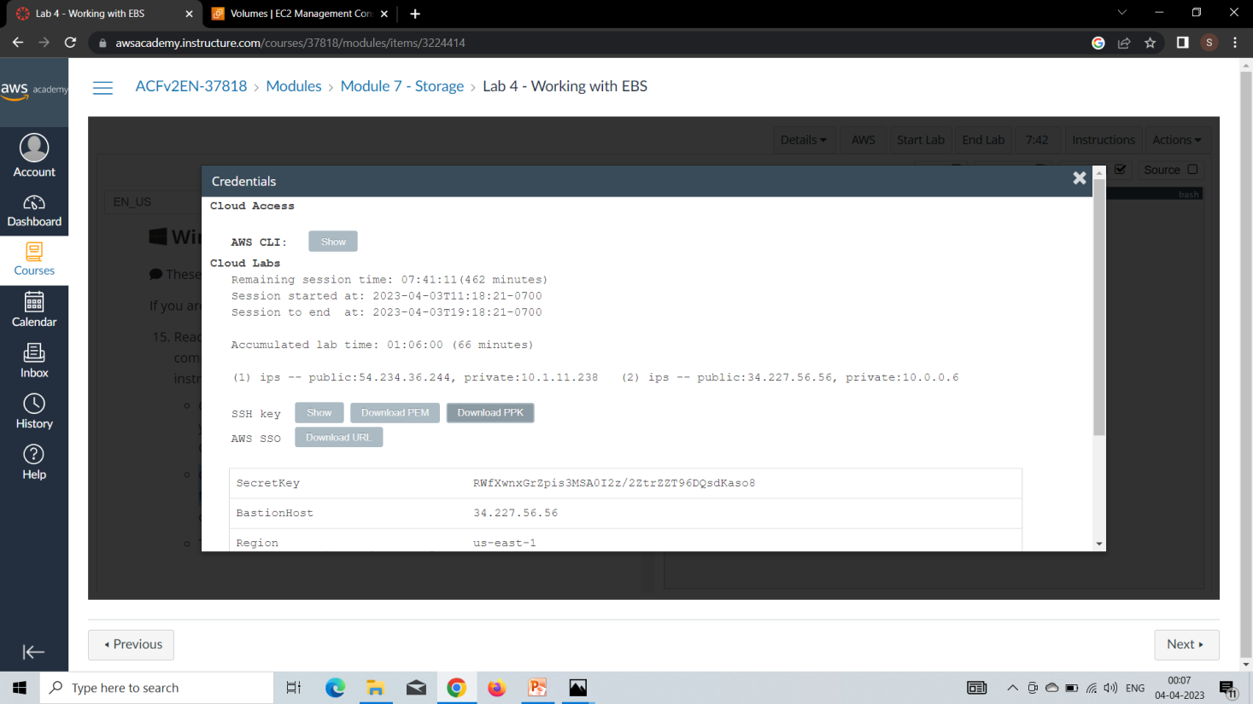
Choose the Details drop down menu above these instructions you are currently reading, and then choose Show
Choose the Download PPK button and save the labsuser.ppk file.

Slide 25
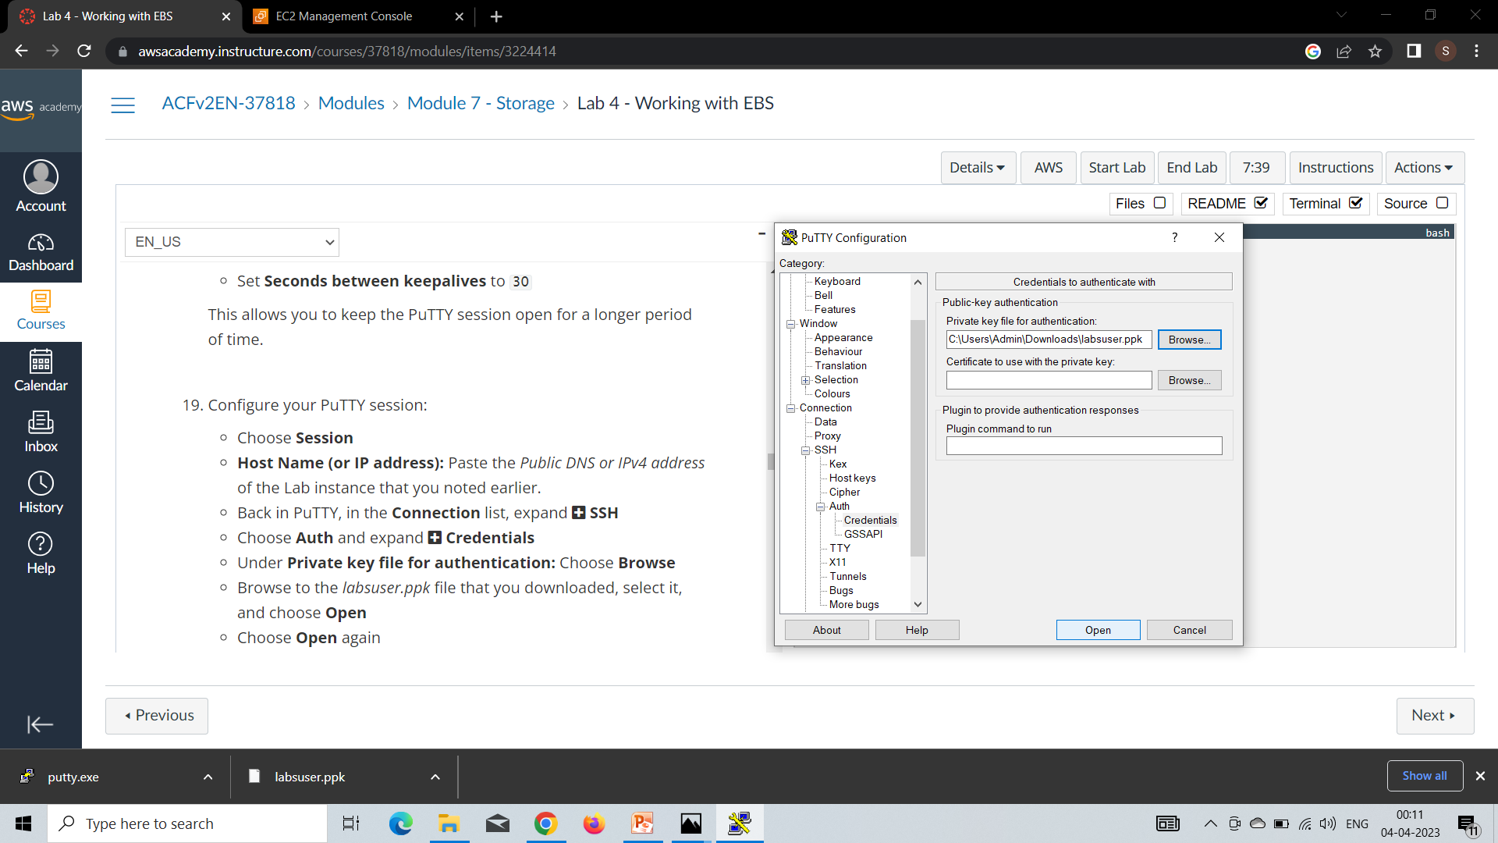
Open putty.exe
Configure your PuTTY session:
Choose Session
Host Name (or IP address): Paste the Public DNS or IPv4 address of the Lab instance that you noted earlier.
Back in PuTTY, in the Connection list, expand SSH
Choose Auth and expand Credentials
Under Private key file for authentication: Choose Browse
Browse to the labsuser.ppk file that you downloaded, select it, and choose Open
Choose Open again. When prompted login as, enter: ec2-user

Slide 26
The putty is ready for executing your commands like creating a directory, viewing a file, creating a file,etc….

Slide 27
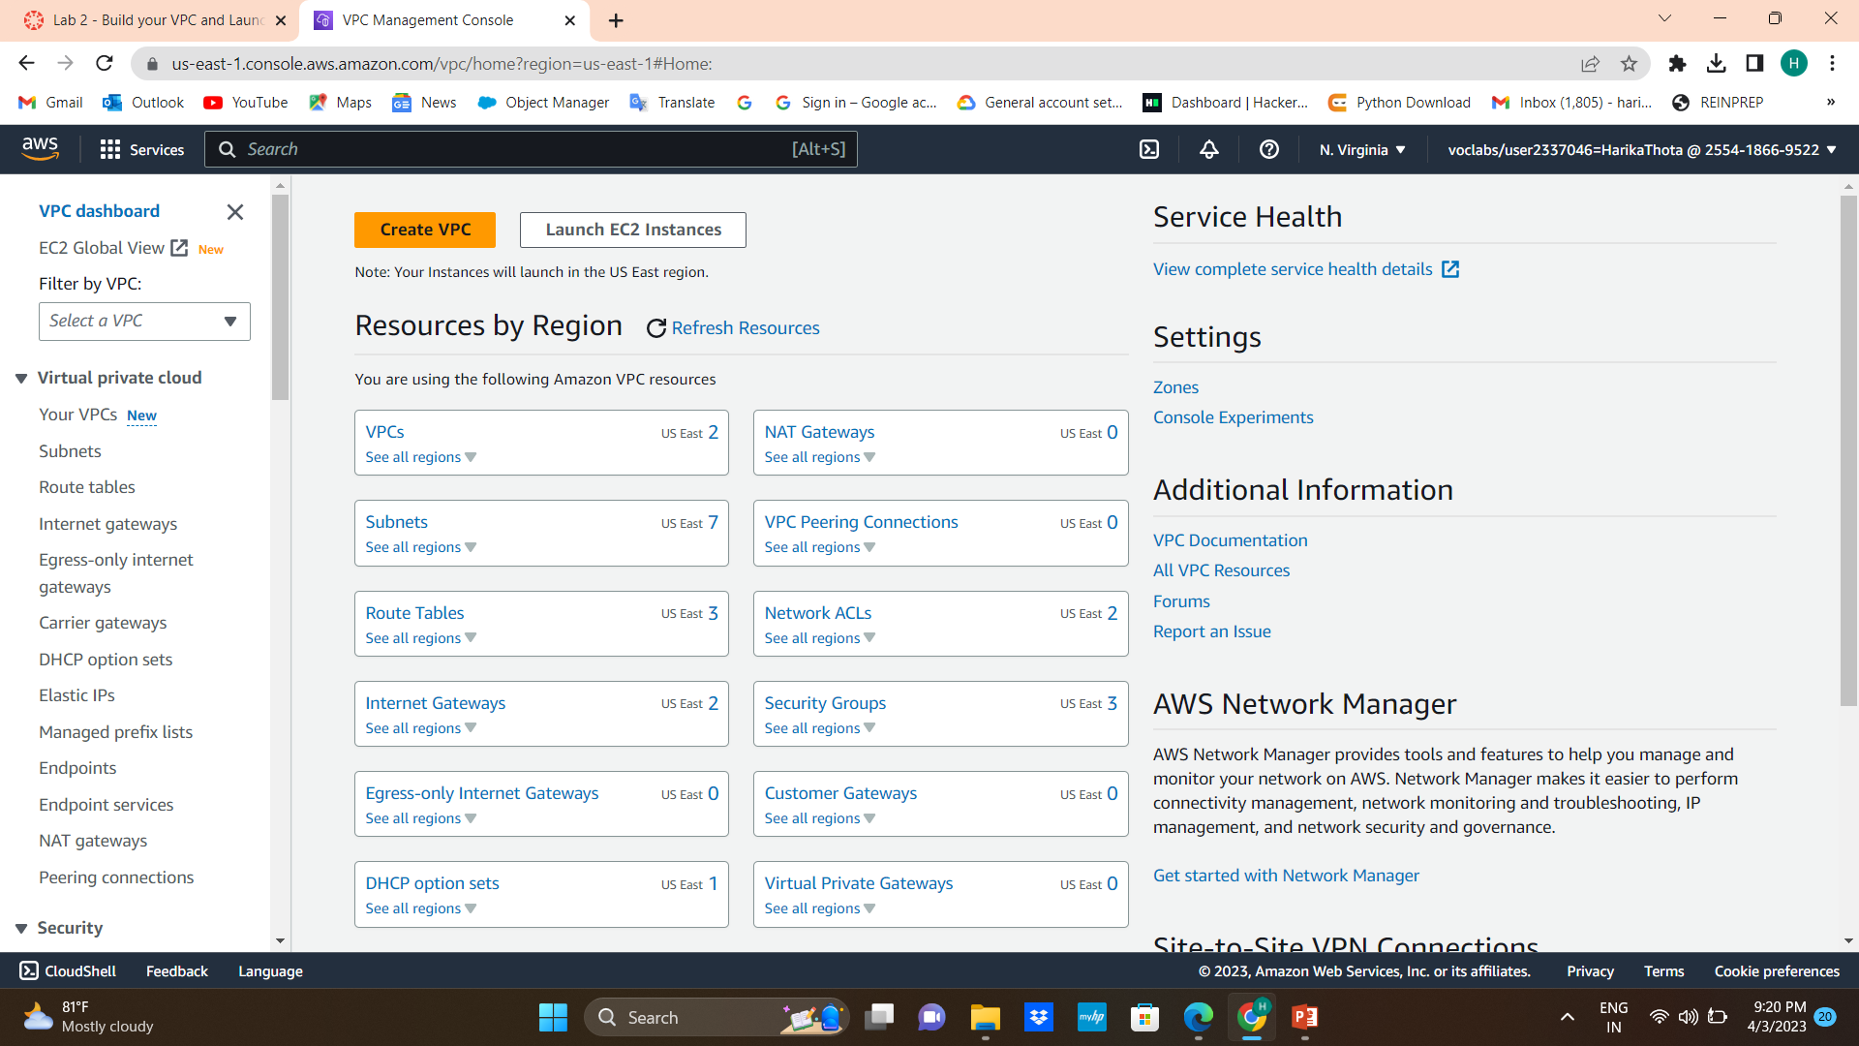
VPC(Virtual Private Cloud)
1. AWS Management Console choose service, choose vpc
2.At the top check the location N. Virginia (us-east-1)
3.Choose the create vpc

Slide 28
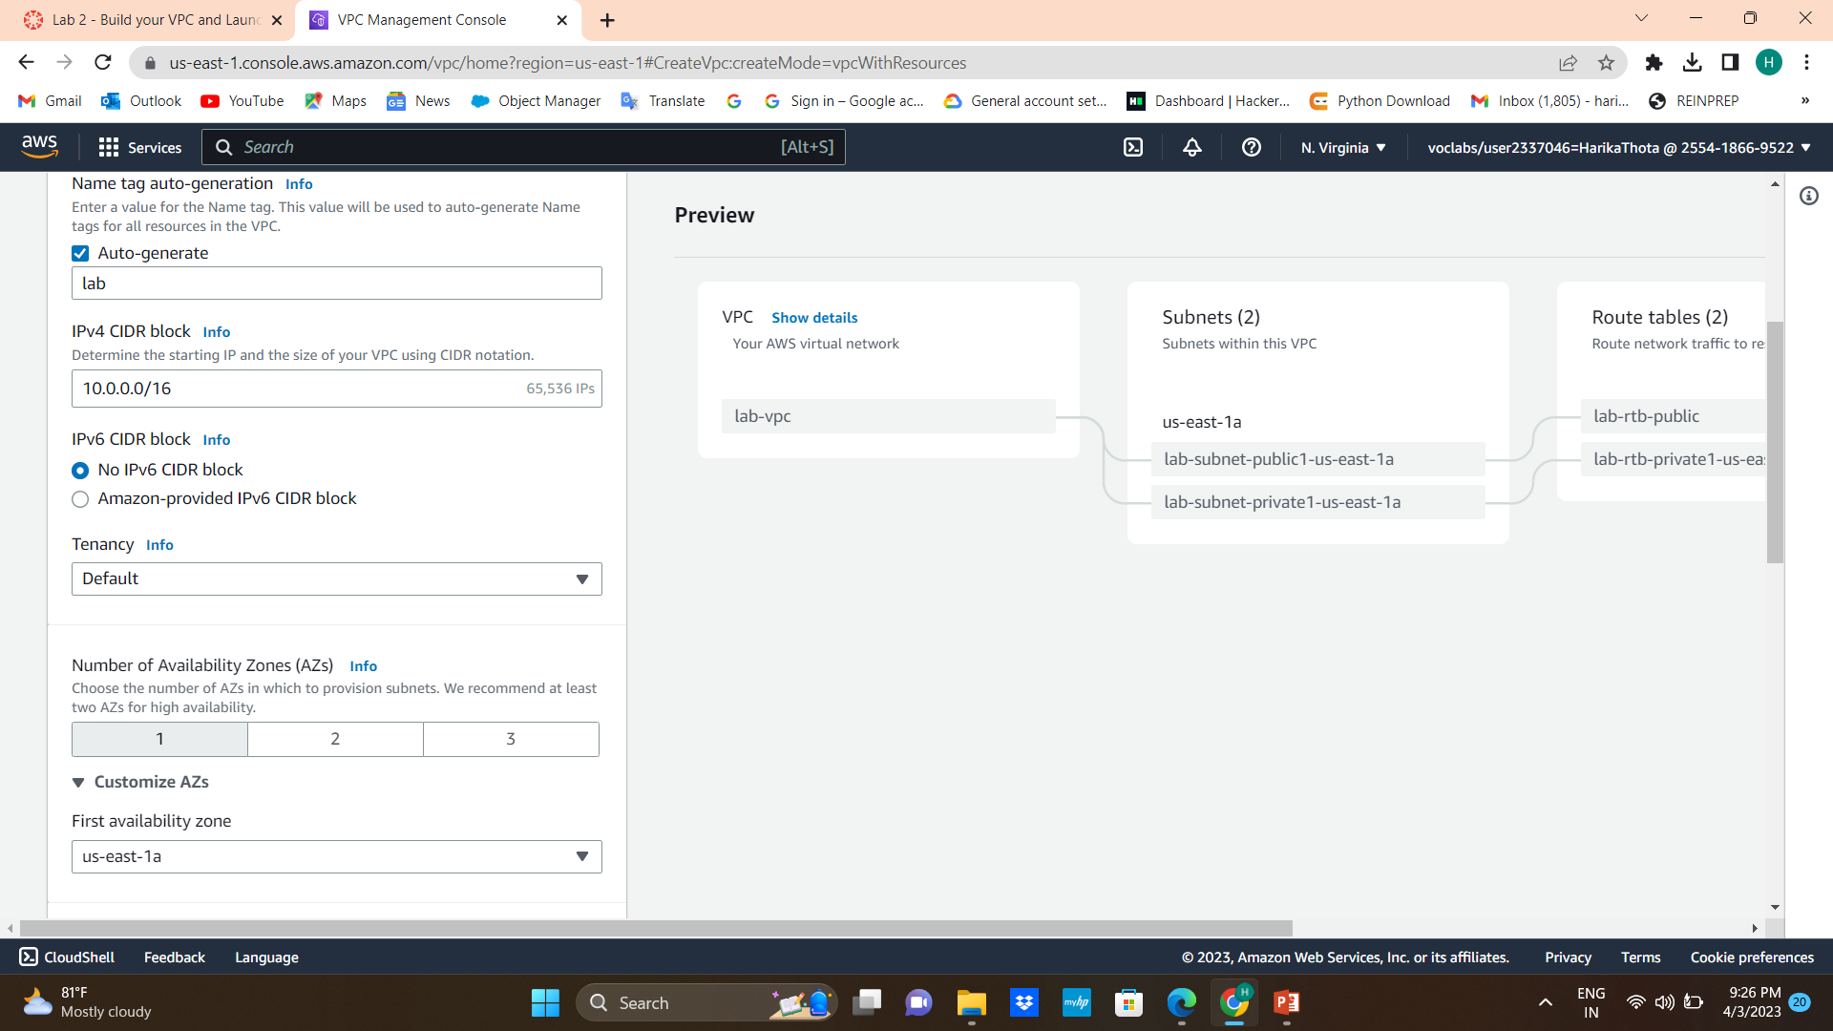
4. Type the name of the vpc
5. Set the no of Availability Zones

Slide 29
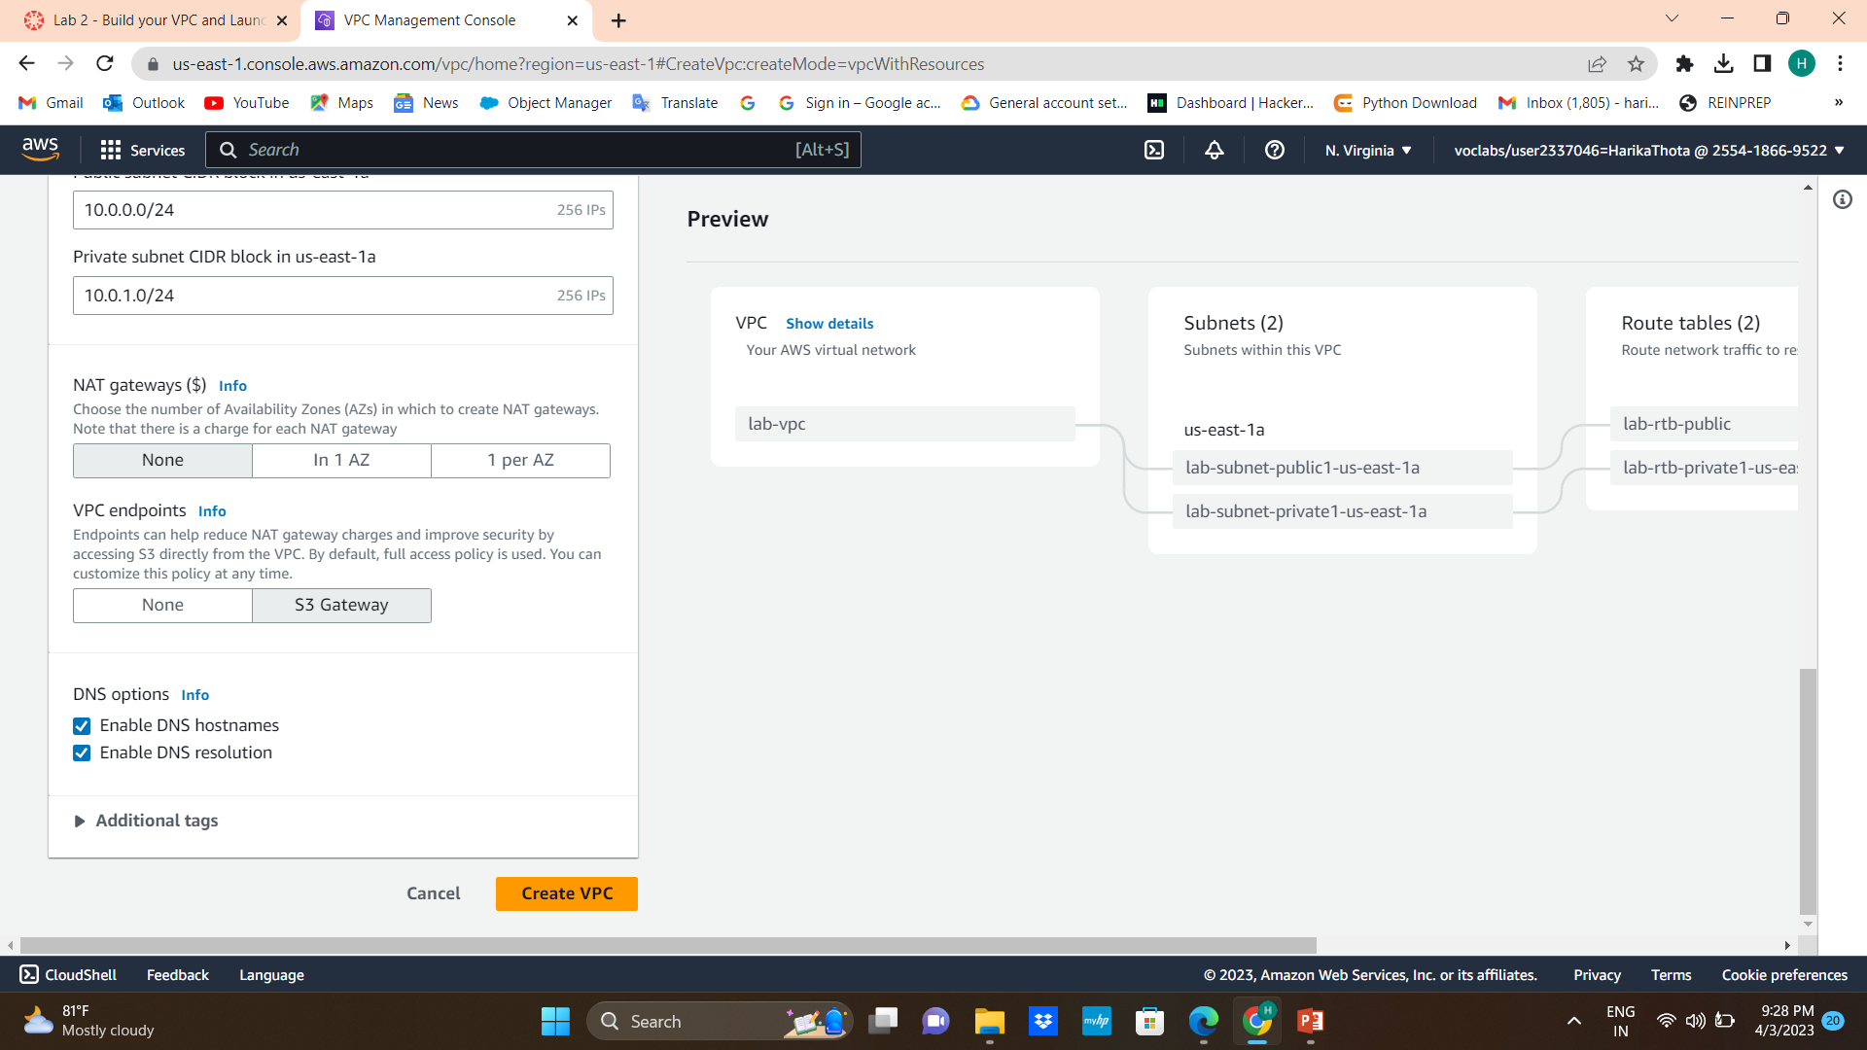
6. Adjust the ip address of public and private ,NAT gateways and VPC endpoints
7.Click on the create vpc

Slide 30
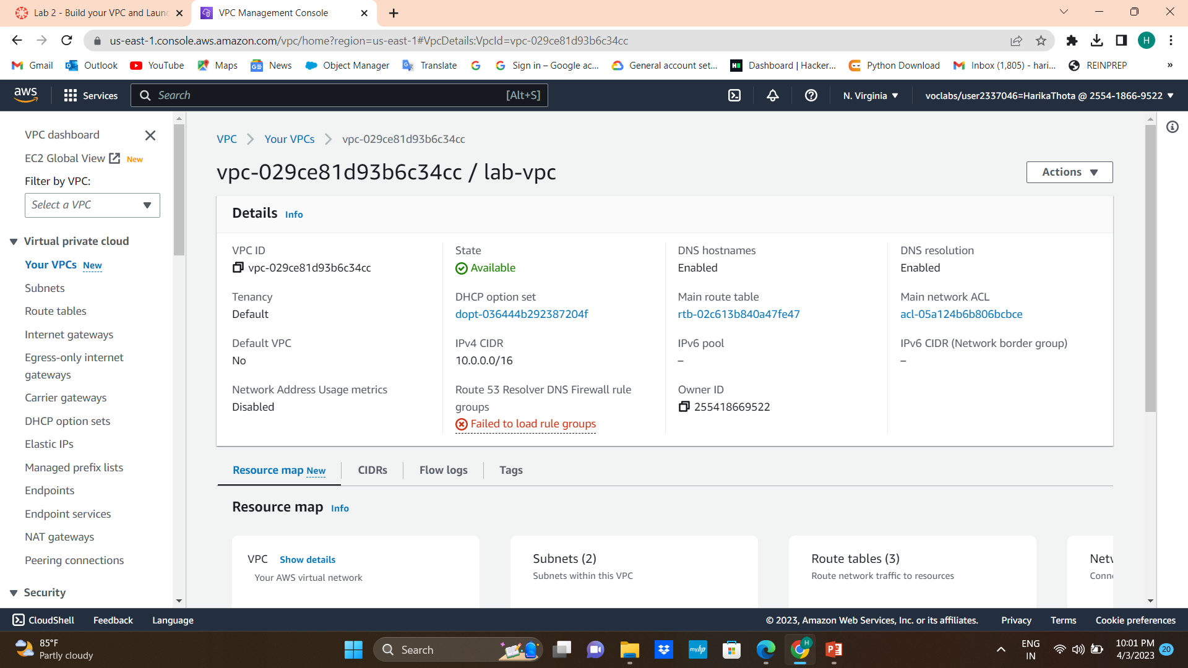
8. Click on view vpc

Slide 31
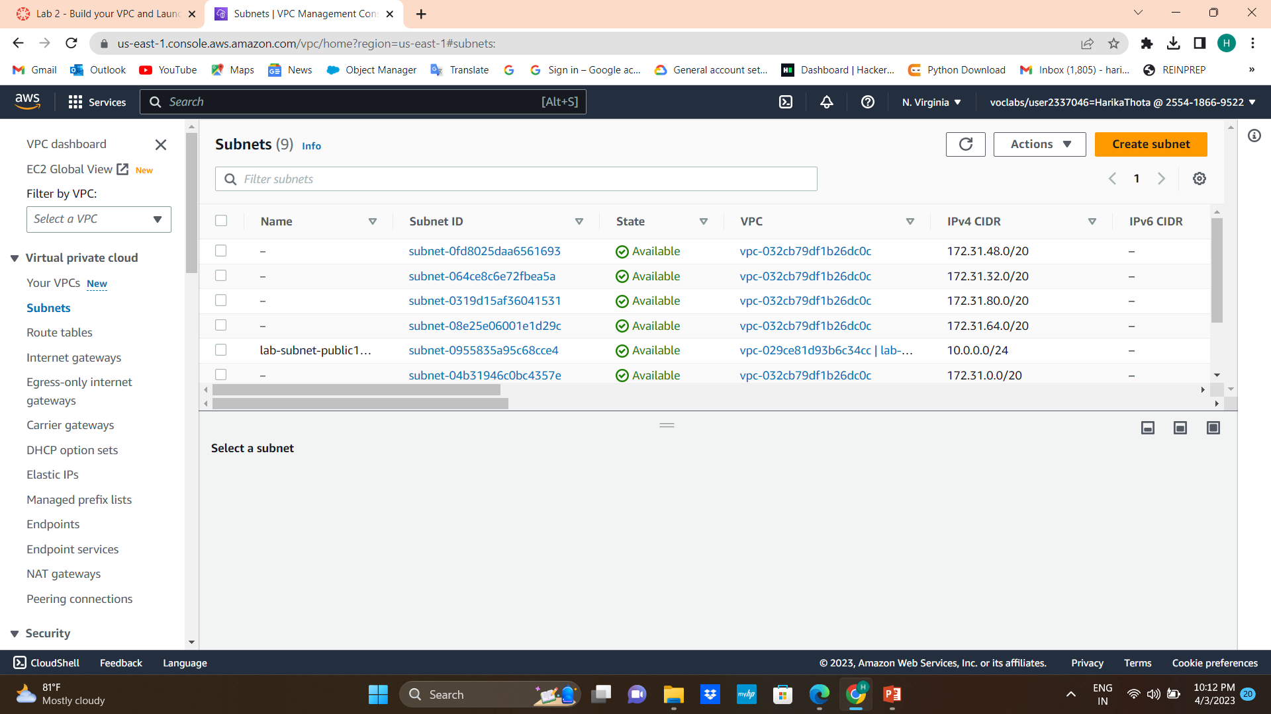
9. In the left navigation pane, choose Subnets.
10.Click on create subnets

Slide 32
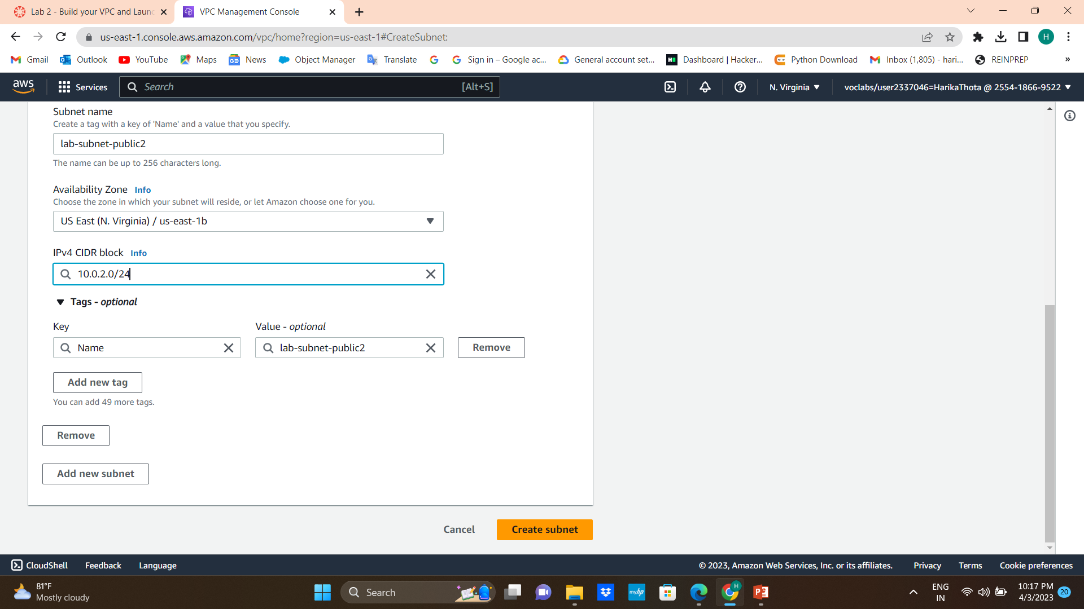
11. VPC ID: lab-vpc (select from the menu).
Subnet name: lab-subnet-public2
Availability Zone: Select the second Availability Zone (for example, us-east-1b)
IPv4 CIDR block: 10.0.2.0/24
12. Click on create subnet

Slide 33
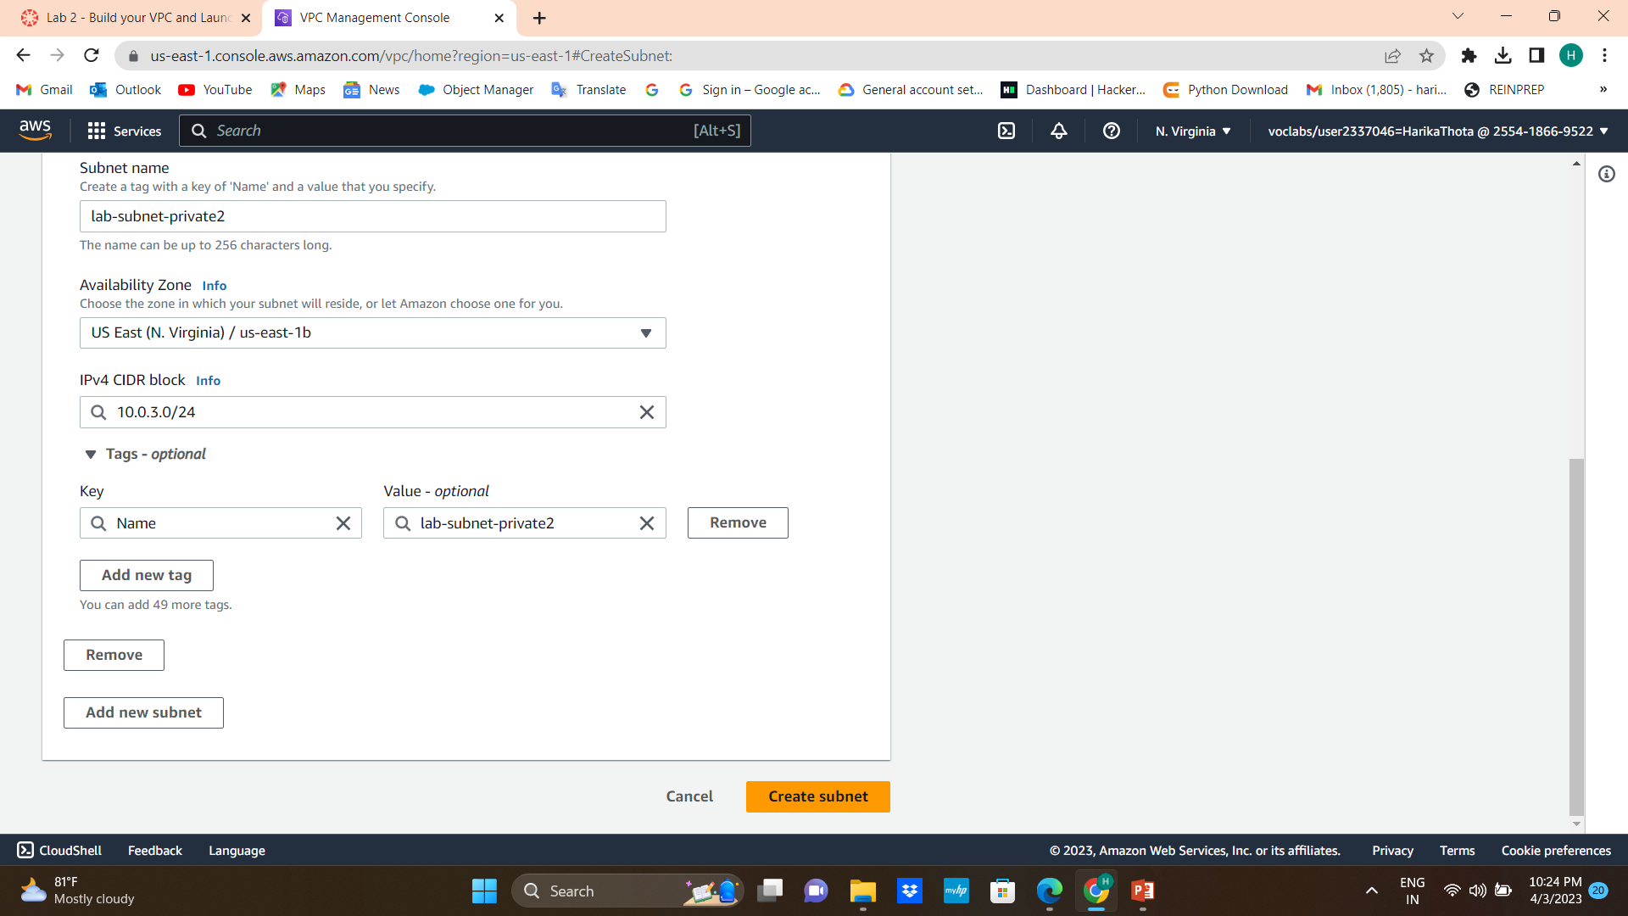
13.Again click on create subnet
VPC ID: lab-vpc
Subnet name: lab-subnet-private2
Availability Zone: Select the second Availability Zone (for example, us-east-1b)
IPv4 CIDR block: 10.0.3.0/24
14. Choose create subnet

Slide 34
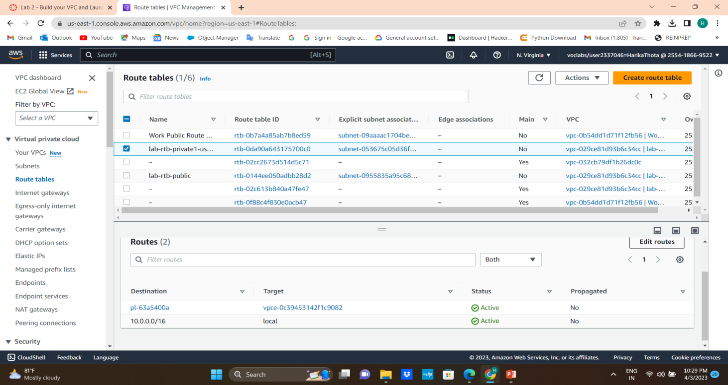
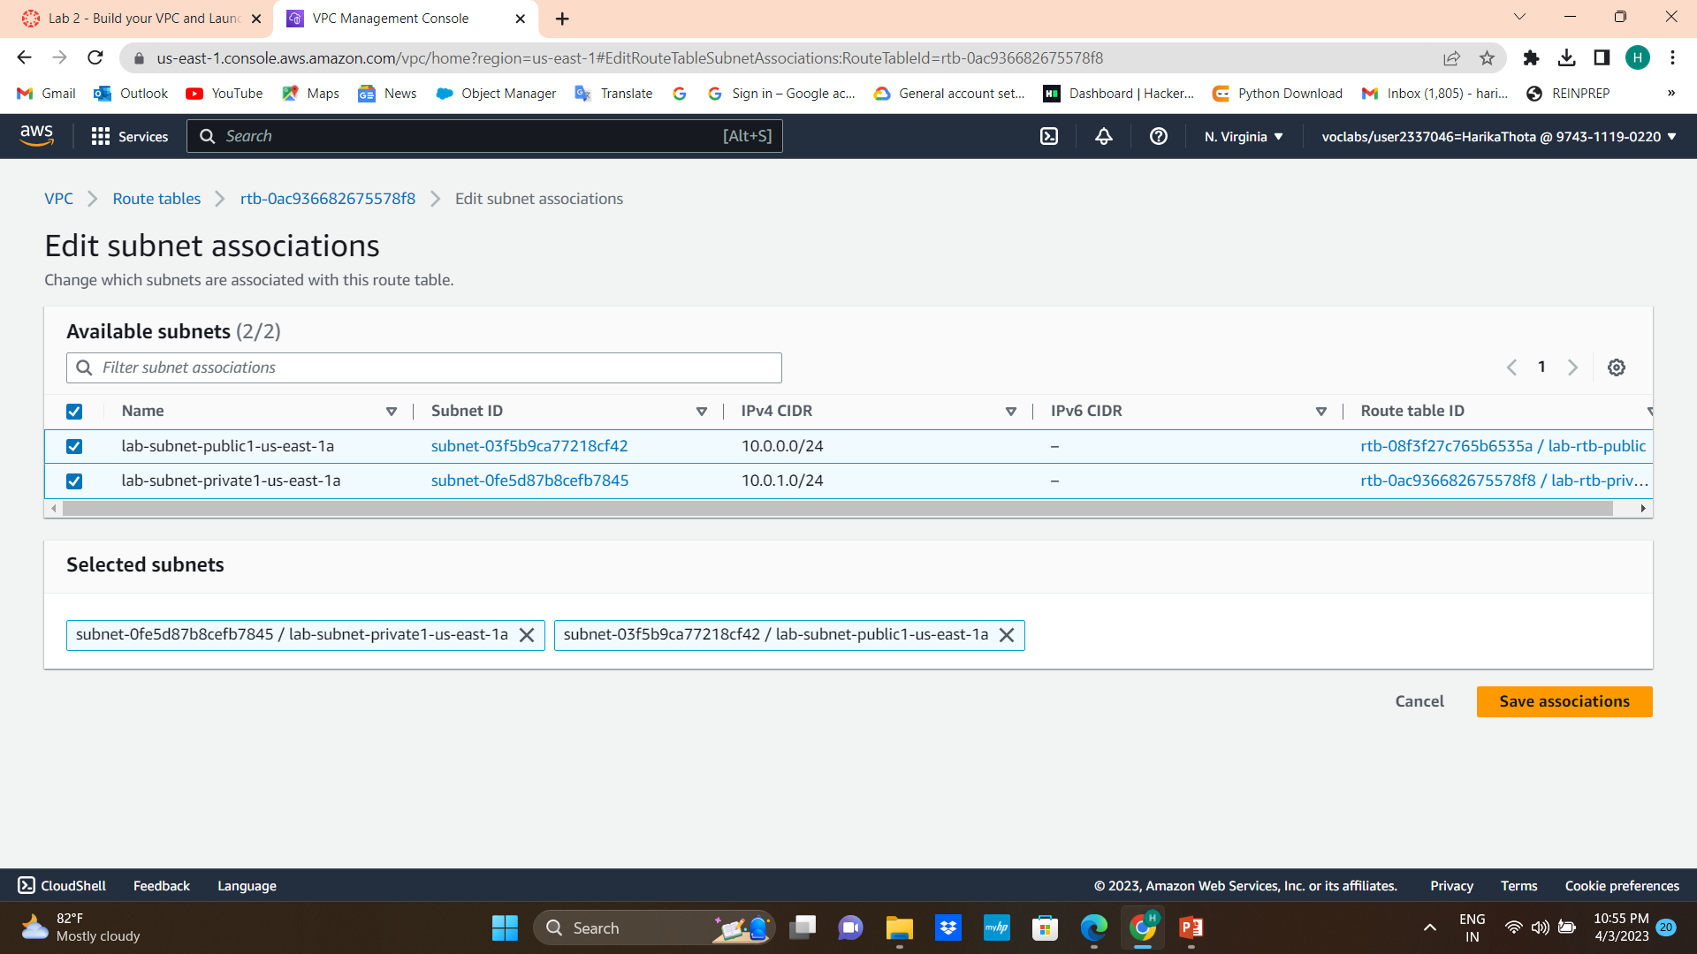
15. In the left navigation pane, choose Route tables.
16. Select the lab-rtb-private1-us-east-1a route table.
17.In the lower pane, choose the Routes tab.
18. Choose the Subnet associations tab and choose Edit subnet associations
19. Leave lab-subnet-private1-us-east-1a selected, but also select lab-subnet-private2 and Save associations

Slide 35
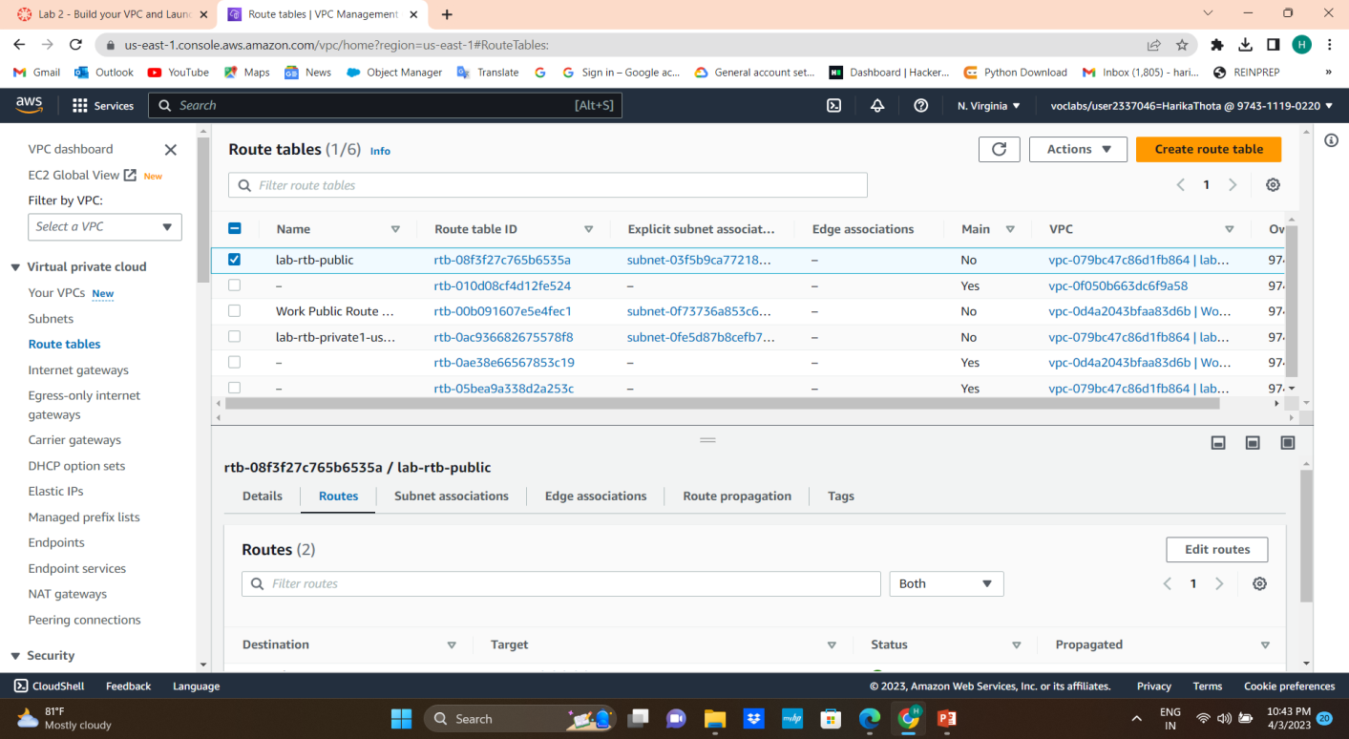

20. Select the lab-rtb-public route table
21. In the lower pane, choose the Routes tab.
22. Choose the Subnet associations tab and choose Edit subnet associations
23. Leave lab-subnet-public1-us-east-1a selected, but also select lab-subnet-public2 and Save associations

Slide 36
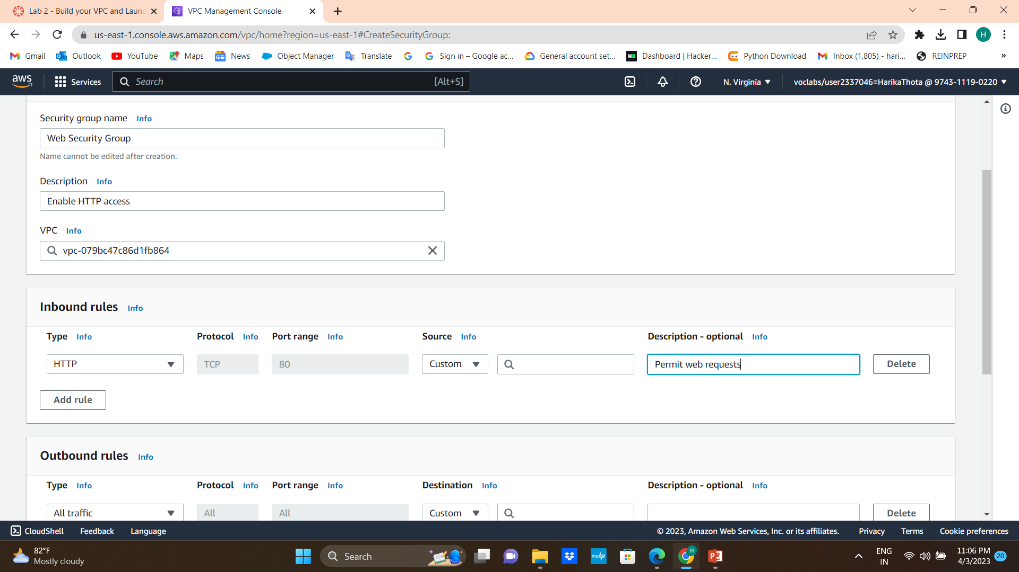
24. In the left navigation pane, choose Security groups.
25.Choose Create security group and then configure
26. Security group name: Web Security Group
Description: Enable HTTP access
VPC: choose the X to remove the currently selected VPC, then from the drop down list choose lab-vpc

Slide 37
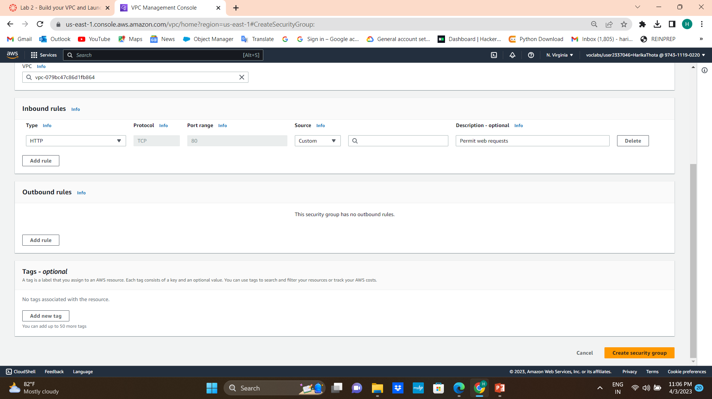
27. the Inbound rules pane, choose Add rules
28. Configure the following settings:
Type: HTTP
Source: Anywhere-IPv4
Description: Permit web requests
29. Scroll to the bottom of the page and choose Create security group

Slide 38
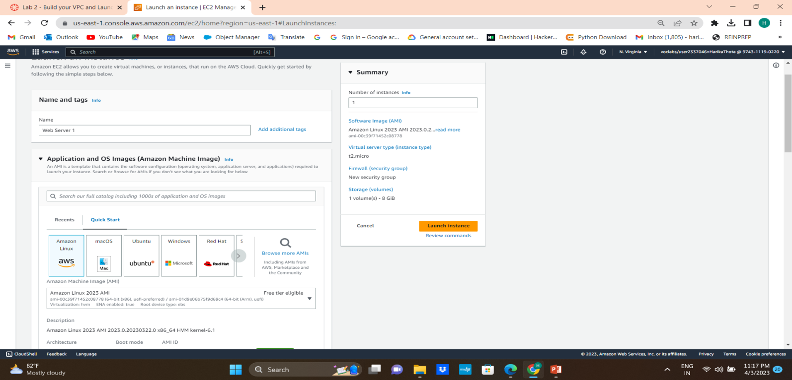
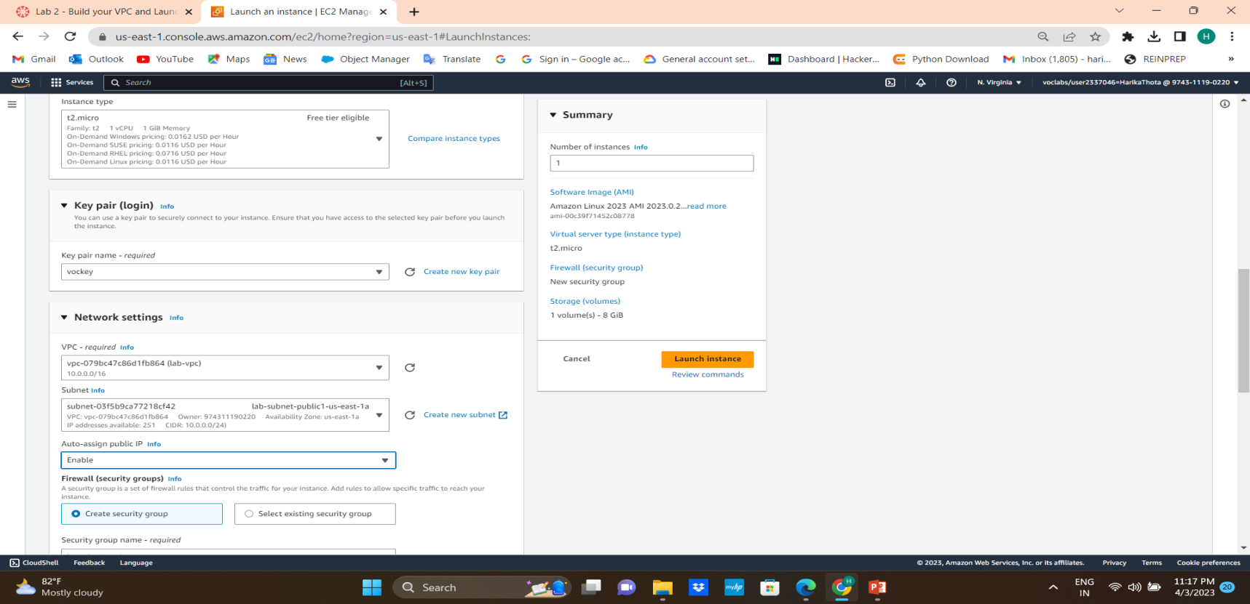
30. Services, search for and choose EC2 to open the EC2 console and choose Launch instance.
31. Name the instance:Web Server 1
32. Choose an AMI from which to create the instance and keep the default Amazon Linux selected.
33. Choose an Instance type:keep the default t2.micro selected.
34. From the Key pair name menu, select vockey.
35. Configure the Network settings:choose Edit, then configure:
Network: lab-vpc
Subnet: lab-subnet-public2 (not Private!)
Auto-assign public IP: Enable

Slide 39
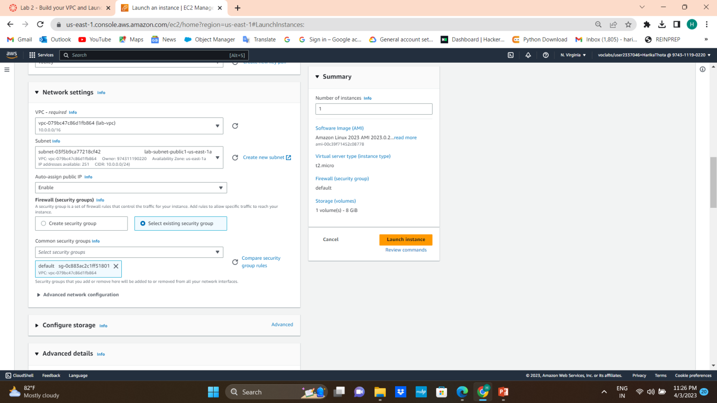
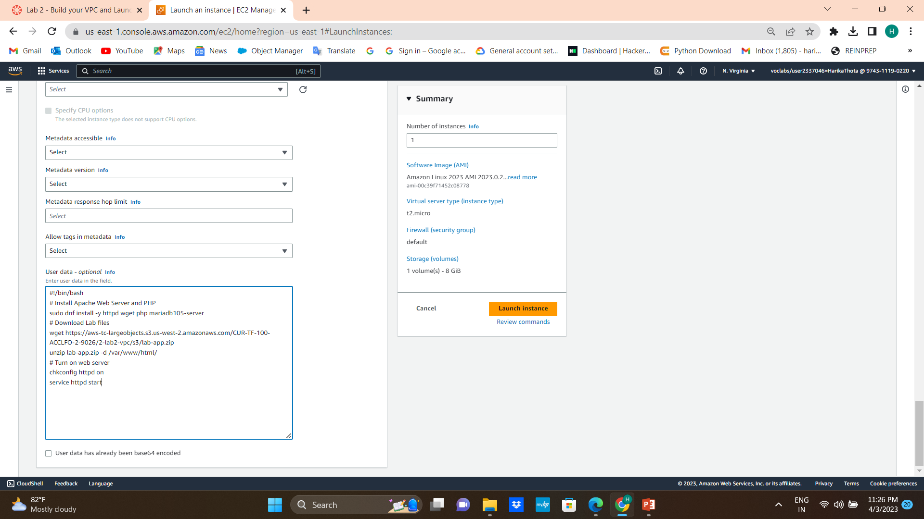
36. Under Firewall (security groups), choose Select existing security group.
37. For Common security groups, select default
38. Expand the Advanced details panel.
39. Scroll to the bottom of the page enter the code in User data
40. choose Launch instance and Choose View all instances

Slide 40
41. Wait until Web Server 1 shows 2/2 checks passed in the Status check column.
42. Select Web Server 1 and Copy the Public IPv4 DNS value shown in the Details tab at the bottom of the page.
43. Open a new web browser tab, paste the Public DNS value and press Enter and you should see a web page displaying the AWS logo and instance meta-data values.

Slide 41
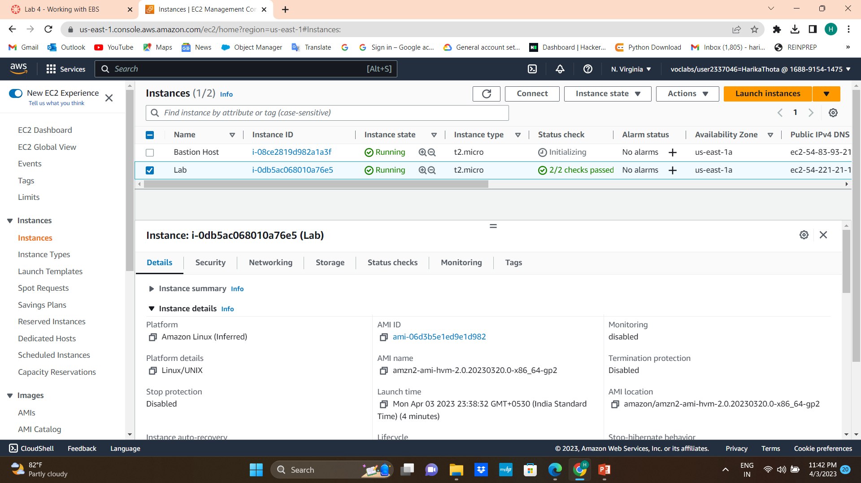
EBS(Elastic Block Store)
In the AWS Management Console, on the Services menu, click EC2.
Choose Instances and an Amazon EC2 instance named Lab has already been launched for your lab

Slide 42
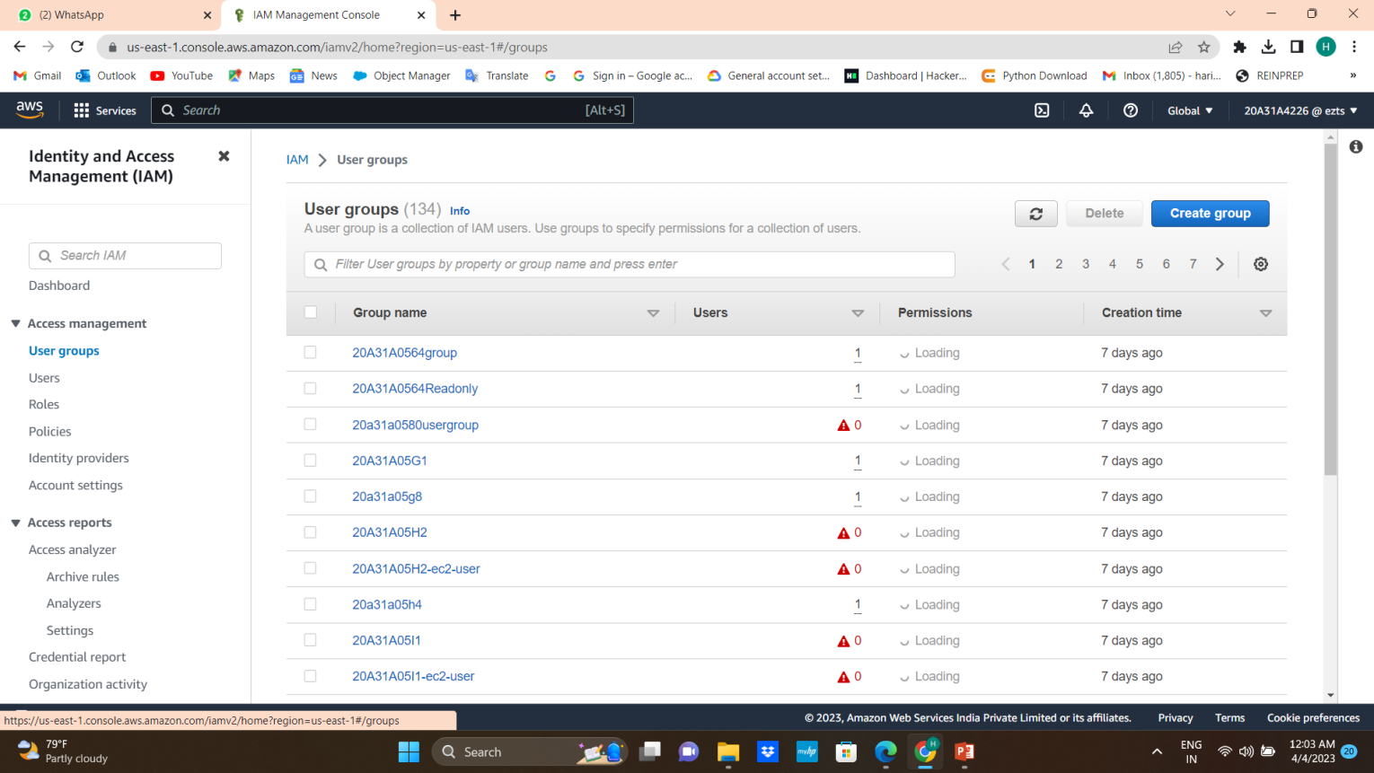
IAM (Identify and Access Management)
1.Login to your AWS account
2.Aws console select IAM
3.From the left pane select users groups and choose create group

Slide 43
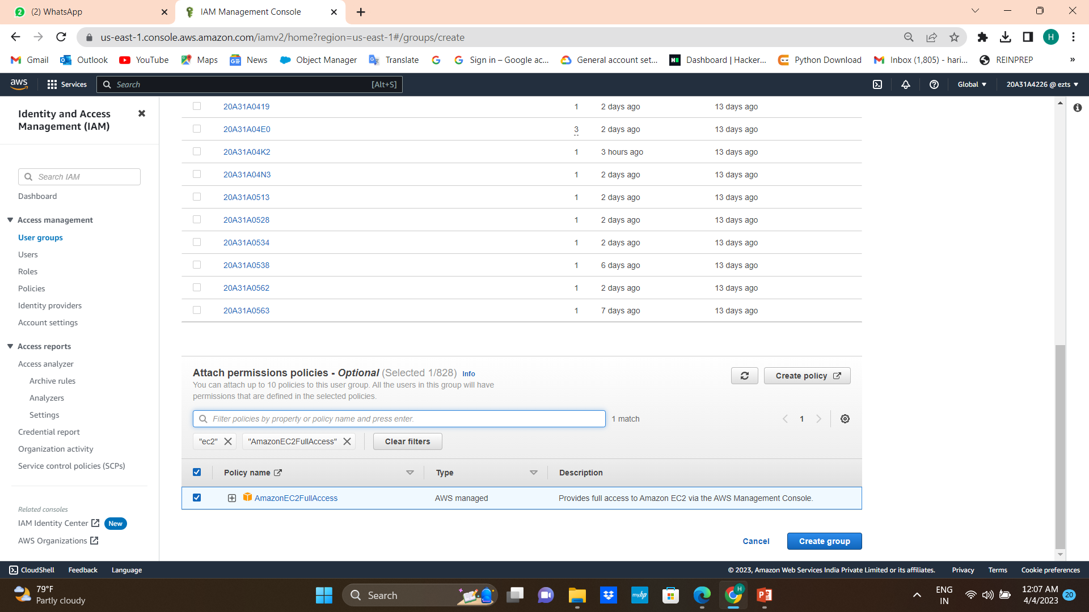
4.Name the user group
5. Attach permissions policies by selecting AmazonEC2FullAccess
6.Click on create group

Slide 44
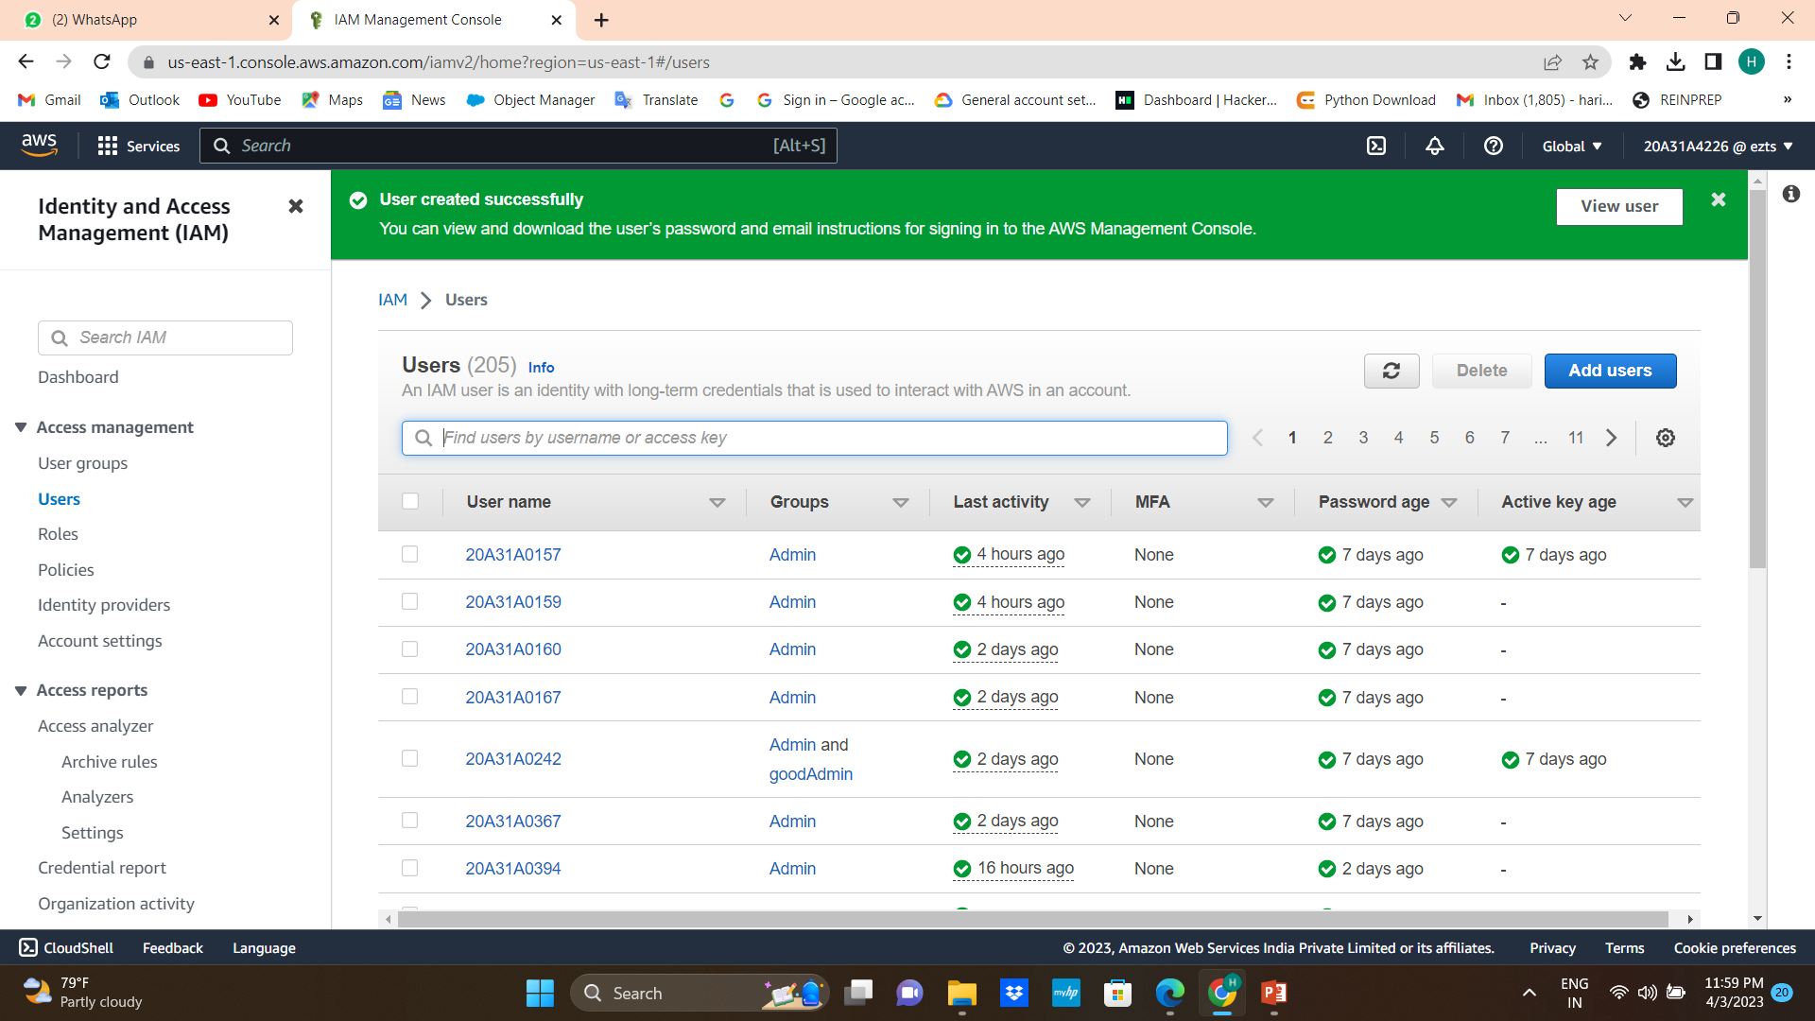
7.Now left pane click on users and then select add users
8.Give the user name and click on next ,next and create user
9.User successfully created

Slide 45
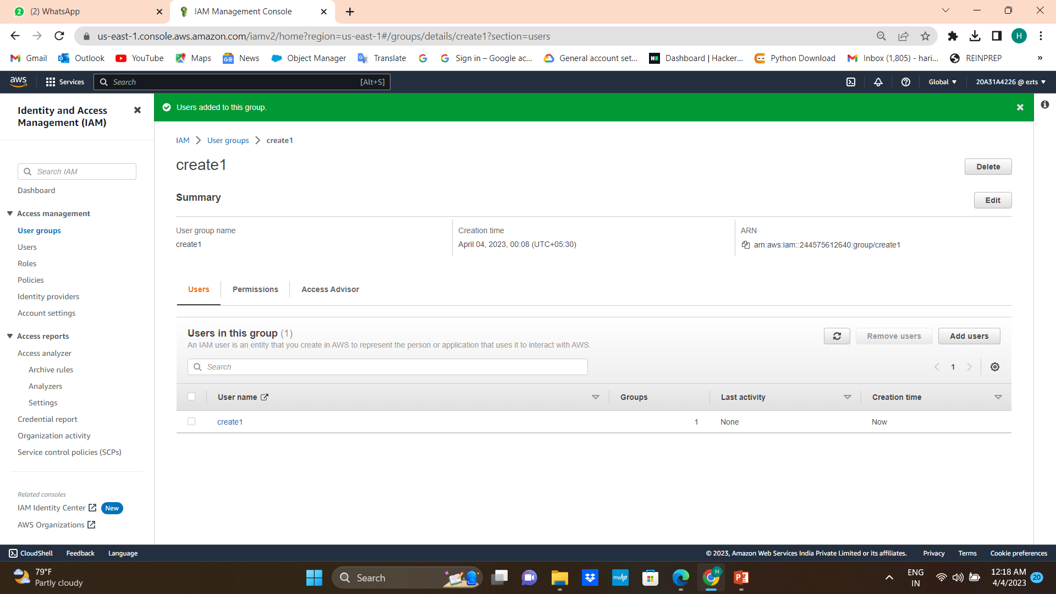
10.Now click on user group and select group the which we created before
11.Scoll down we add user click on it and select the user which we created
12. Finally we created adding users to the group

Slide 46
THANK YOU

